Slide 1
Prompting The Law:
Overcoming Methodological Challenges in LLM Legal Content Generation
By
Emma Elliott, VP Operations, Lexum
Frédéric Pelletier, VP Legal Information, Lexum
LVI 2024 Conference
Limassol, Cyprus
2024-09-27

Slide 2

Introduction
Where are we now with NLP?
Where is Lexum now?
Content generation workflows
Production workflows
The future
To keep in mind

Slide 3
Where are we now with NLP?
Natural Language Processing (NLP) milestones
  1950–1980: Symbolic (rules-based learning)
  1980–2000: Statistical (learning from data)
  2000–2017: Neural networks (deep learning)
    “Embeddings”
    “Parameters”
  2017–Present: Transformer (parallel processing)

Slide 4
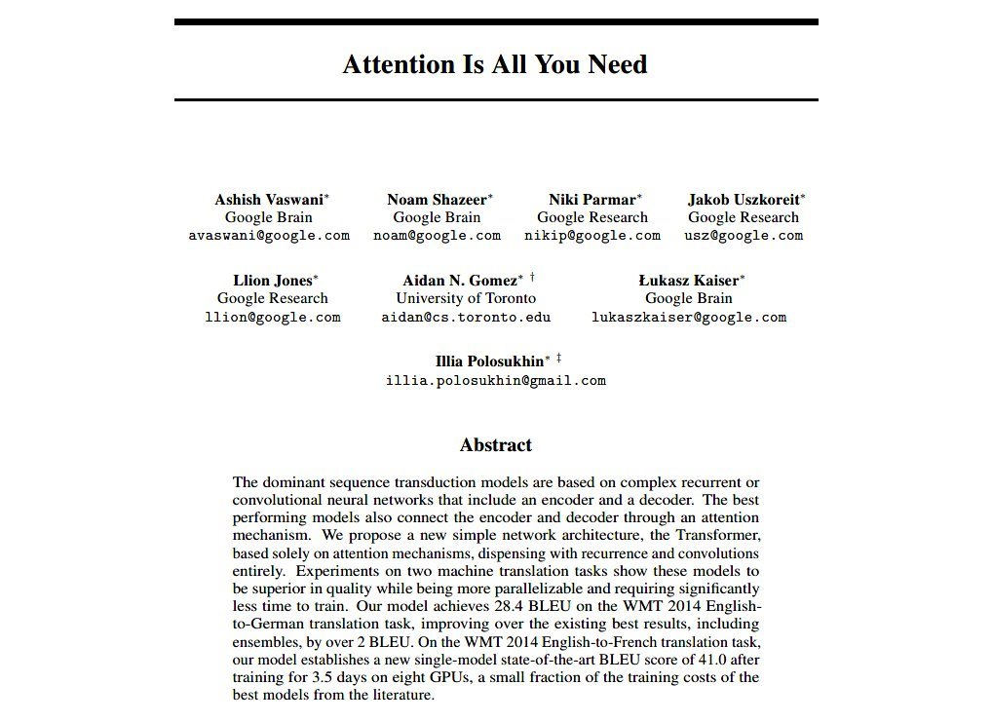

Slide 5
Where are we now with NLP?
Natural Language Processing (NLP) milestones
  1950–1980: Symbolic (rules-based learning)
  1980–2000: Statistical (learning from data)
  2000–2017: Neural networks (deep learning)
    “Embeddings”
    “Parameters”
  2017–Present: Transformer (parallel processing)
    “Context window”

Slide 6
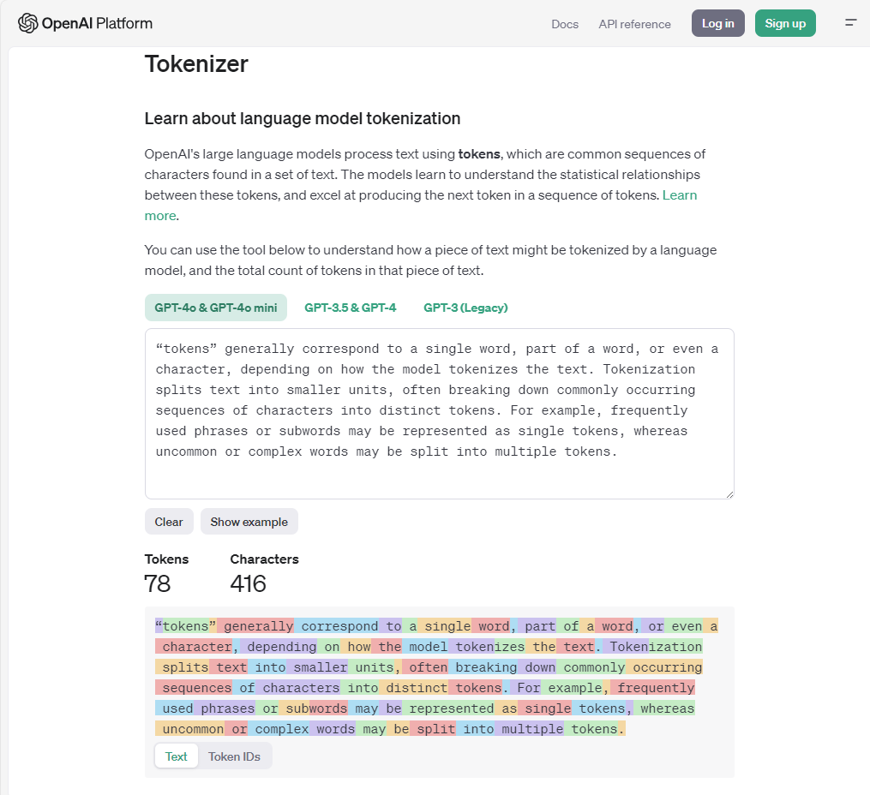

Slide 7
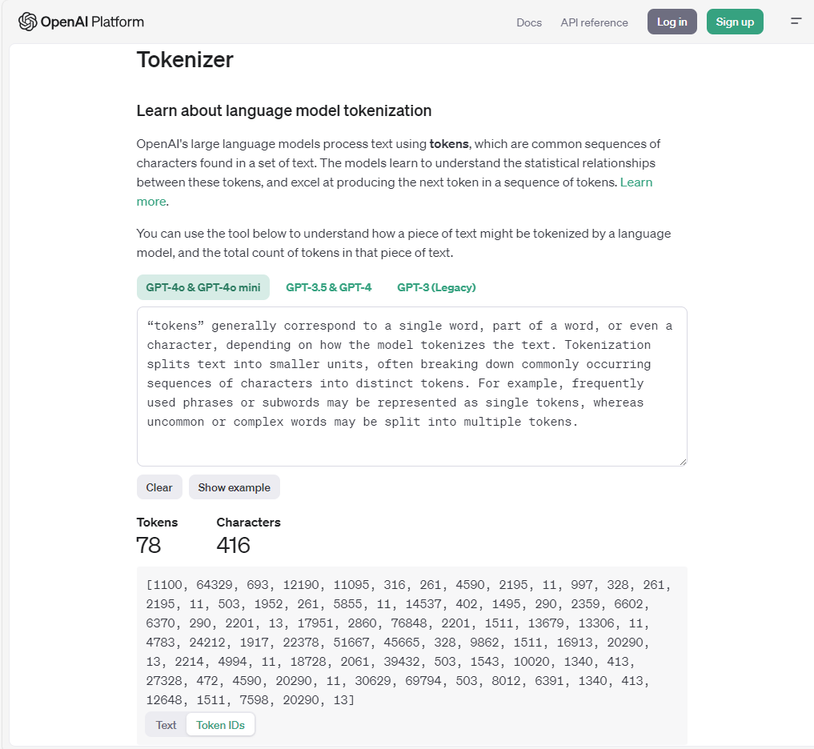

Slide 8
Capability of generative AI
Year/Models | Parameters | Context window (tokens)
2018 – Google BERT (Bidirectional Encoder Representations from Transformers) | 110–340 million | 512
2019 – OpenAI GPT-2 (Generative Pre-trained Transformer 2) | 1.5 billion | 1,024
2020 – OpenAI GPT-3 | 175 billion | 2,048
2022 – GPT-3.5 | 175 billion (unconfirmed) | 4,096
2023-03 – GPT-4 | 1+ trillon | 8,192
2023-03 – GPT-4 | (undisclosed) | 32,048
2023-09 – Anthropic Claude 2 | 70 billion (unconfirmed) | 100,000+
2023-11 – GPT-4 Turbo | 1.8 trillion | 128,000

Slide 9
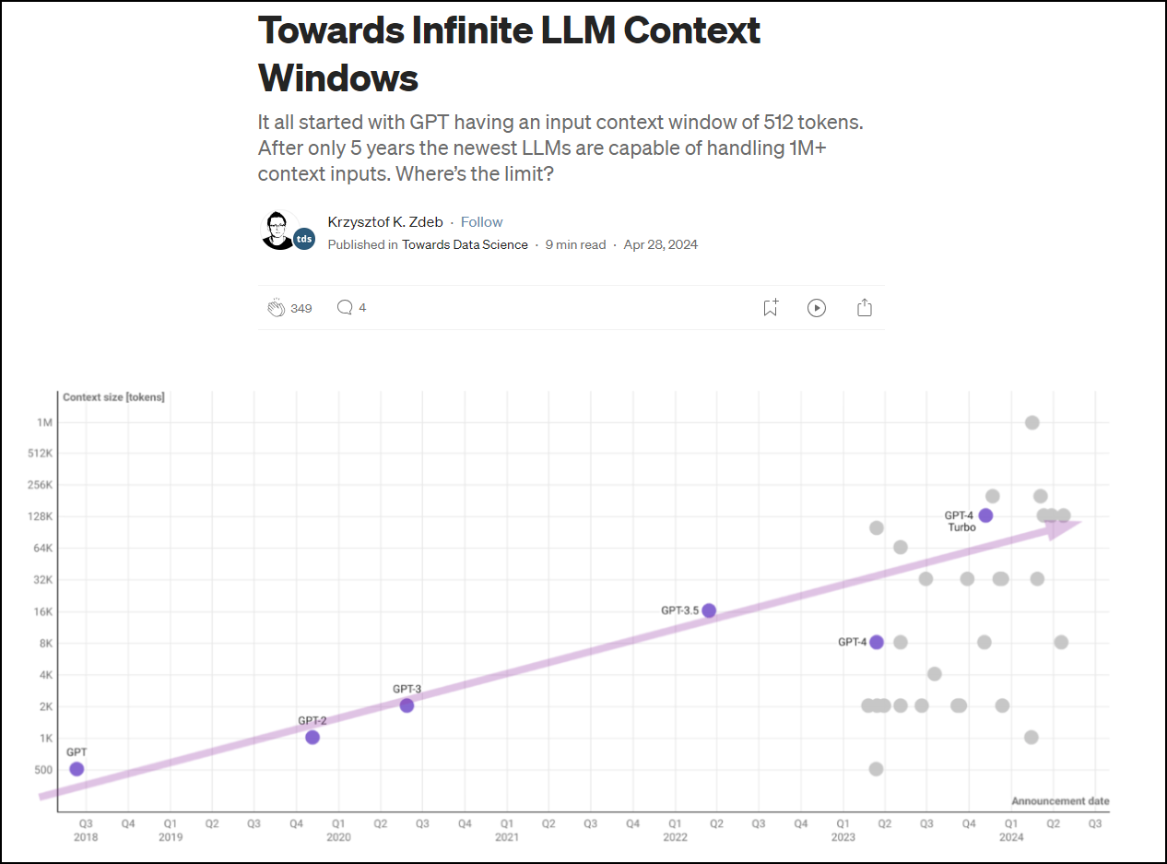

Slide 10
When can generative AI be used?
Since generative AI
  Is merely probabilistic
  Has no pretensions to the production of meaning
  Needs context to work properly
It is good at processing documents for
  Extracting data
  Summarizing
  Drafting text

Slide 11
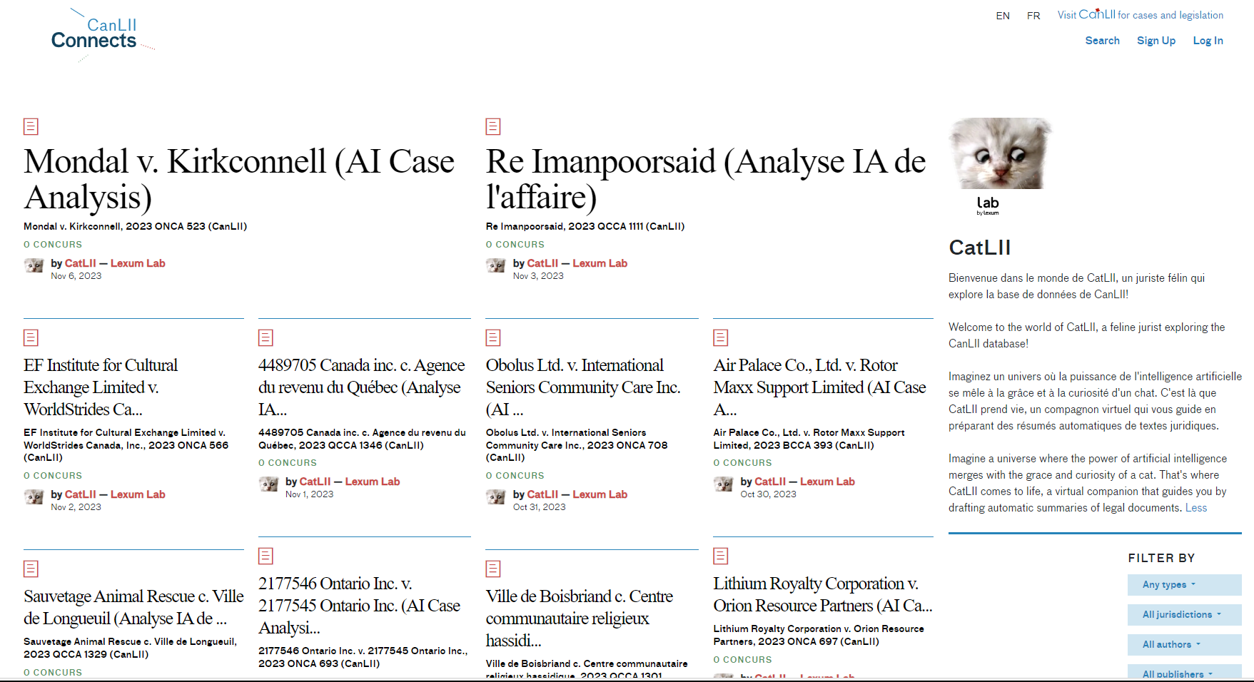
The CatLII pilot (2023)

Slide 12
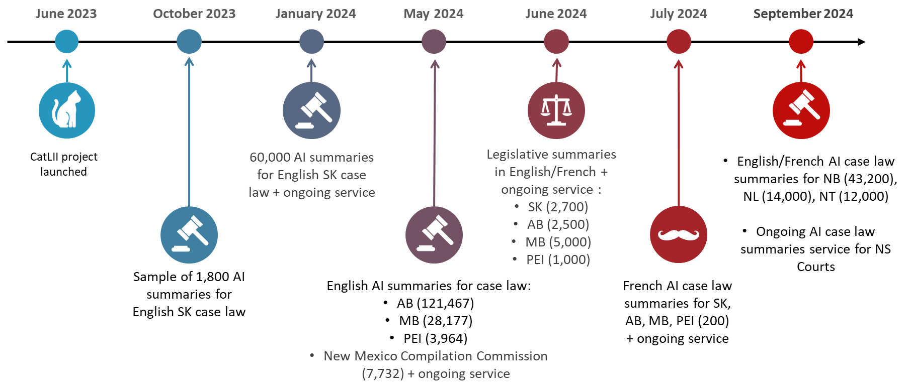
2. Where is Lexum now?

Slide 13
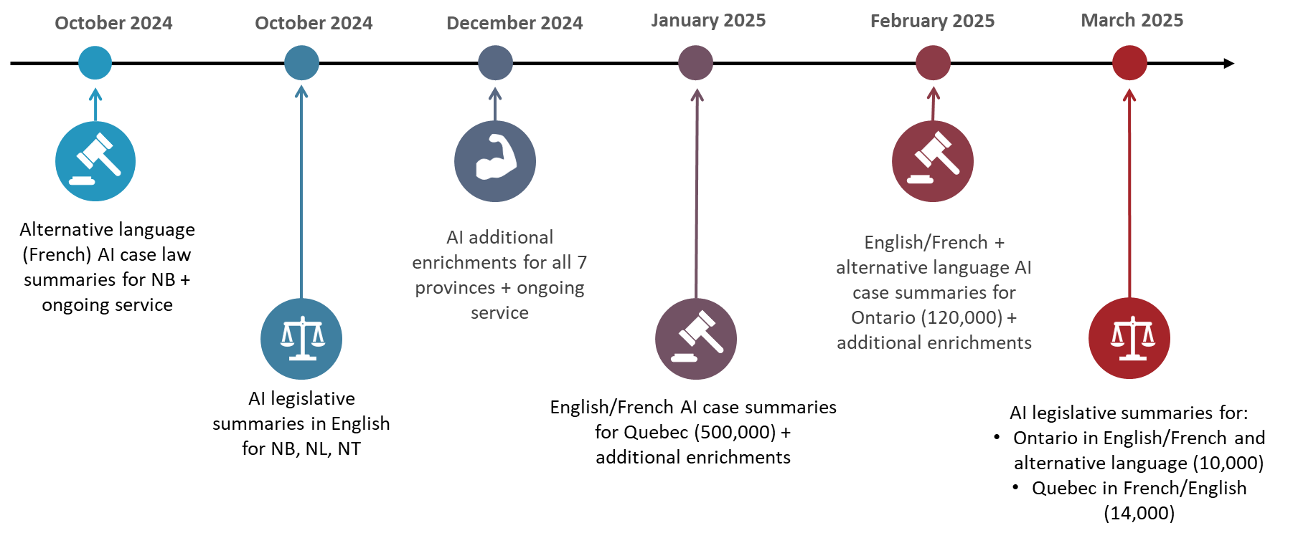
2. Where is Lexum now?

Slide 14
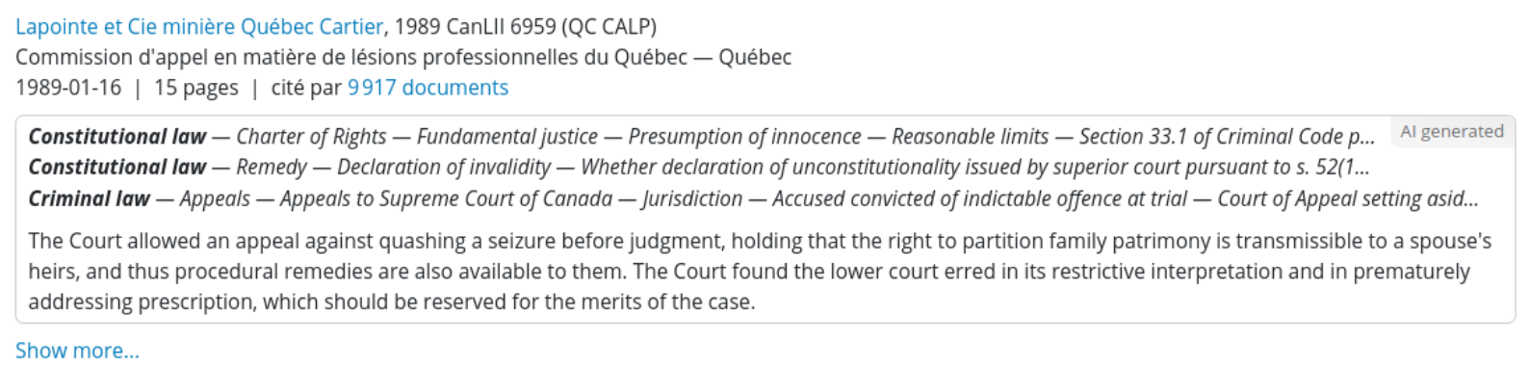
2. Where is Lexum now?

Slide 15
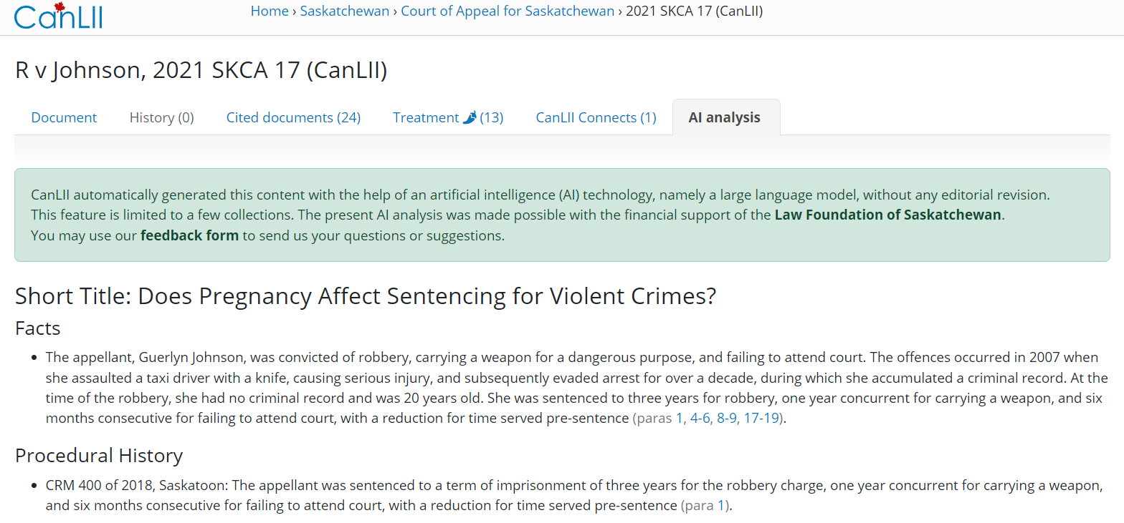
2. Where is Lexum now?

Slide 16
2. Where is Lexum now?
Evolution of LLM landscape
  Access to LLM services
  Costs
Company organization
  Dedicated IT team + close collaboration with product teams
    LexSummary
    Playground
  Legal information analysts team
  Business model development

Slide 17
3. Content generation workflow
Our starting point in late 2023
Trial-and-error approach

Slide 18
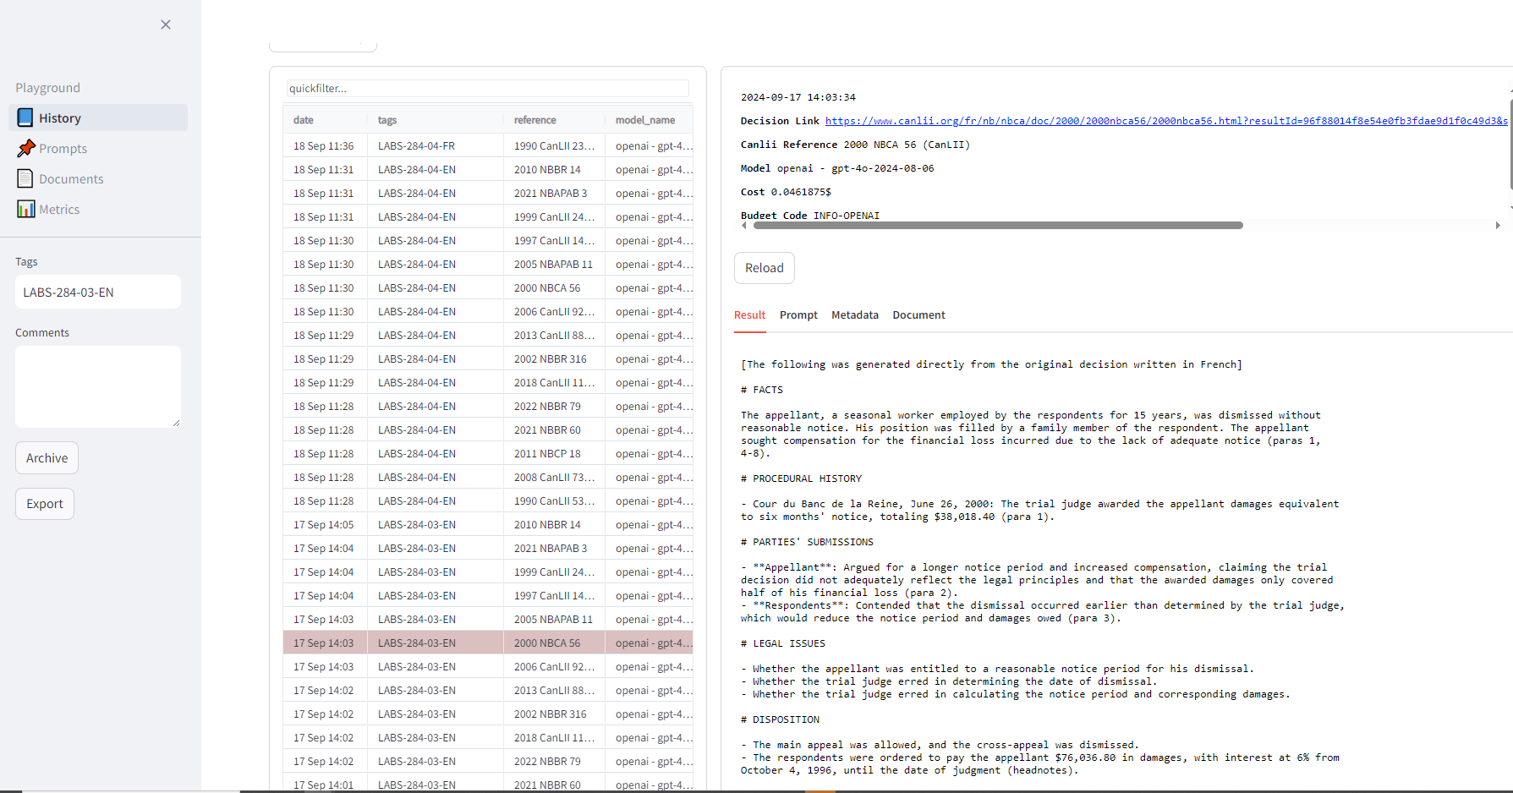

Slide 19
3. Content generation workflow
Our starting point in late 2023
Trial-and-error approach
Prompting
  No foolproof prompt writing tool or technique
  Clear and unambiguous
  Terms of art, not newly defined concepts
  Missing or unreliable information management
  Context
  Chain of thought

Slide 20
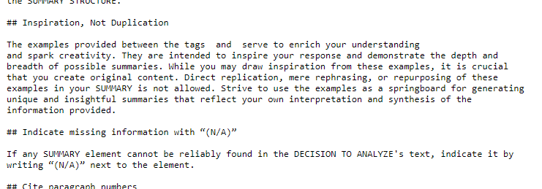

Slide 21
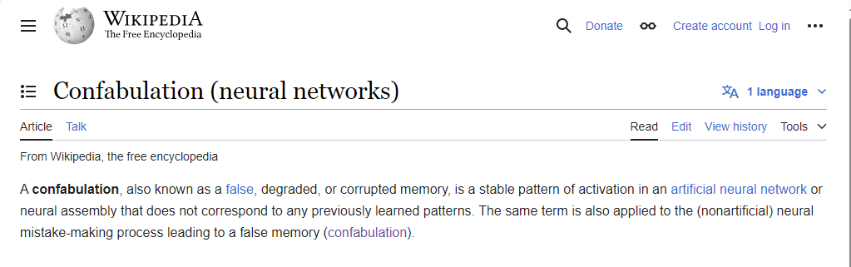
“This act demonstrates that the Government of Manitoba is sensitive to the hardships of disabled persons”

Slide 22
3. Content generation workflow
Our starting point in late 2023
Trial-and-error approach
Prompting
  No foolproof prompt writing tool or technique
  Clear and unambiguous
  Terms of art, not newly defined concepts
  Missing or unreliable information management
  Context
  Chain of thought

Slide 23


Slide 24
3. Content generation workflow
Our starting point in late 2023
Trial-and-error approach
Prompting
  No foolproof prompt writing tool or technique
  Clear and unambiguous
  Terms of art, not newly defined concepts
  Missing or unreliable information management
  Context
  Chain of thought

Slide 25
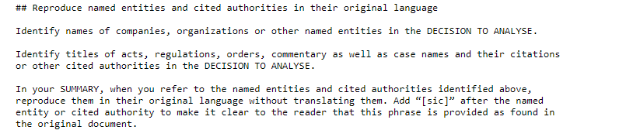

Slide 26
3. Content generation workflow
Our starting point in late 2023
Trial-and-error approach
Prompting
  No foolproof prompt writing tool or technique
  Clear and unambiguous
  Terms of art, not newly defined concepts
  Missing or unreliable information management
  Context
  Chain of thought
A rigorous content generation workflow must be implemented

Slide 27
3. Content generation workflow
1. Determination of the expected content and format
2. Writing the prompt and preliminary testing
3. Project-specific testing
  Terms to monitor
  Validations
  Post-processing
4. Setting up the product-specific workflow
5. Simulation of the production launch
  Detect monitored terms
  Back to step 2 and 3 as needed
6. Monitoring ongoing and past generations

Slide 28
4. Production workflows
Integration of AI generated content into different publication platforms
  CanLII --> case law publication platform (NED), legislation publication platform (Justinien)
  Decisia --> SaaS publication platform
IT workflow design and validation processes that consider the needs of system users (“editors”)
  CanLII --> heavy on business logic
  Decisia --> more agnostic and flexible

Slide 29
4. Production workflows
Deployment
  gradual roll-out vs. hard switch
  demo environment necessary or not
  invoicing and reporting mechanisms
  training and support services
Post-deployment considerations

Slide 30
5. The future
LLM with fine-tuning
  Provide the LLM with 50-100 actual examples in addition to its context window
  More control over the generated content, with simpler prompts
  MLOps – LLM Monitoring and Observability
  Using an LLM to assess the quality of what it produces
  Letting the LLM improve and adjust the prompting by itself

Slide 31
6. To keep in mind
Content produced by a generative AI system
    Is not in itself meaningful; it consists of a series of statistically probable words
    May appear accurate and truthful at first glance, while being biased, incomplete, erroneous, or even false
  To properly use a generative AI system
    Choosing the right tool for professional use
    Provide clear, precise instructions and context
    Experiment, "play" with the tool to learn its limits
    Keep humans involved!

