Slide 1
LAW VIA INTERNET
Publication of judgments by the Supreme Court
ELEFTHERIA ARALIOU,LEGAL OFFICER
lpd, SUPREME COURT OF CYRRUS

Slide 2
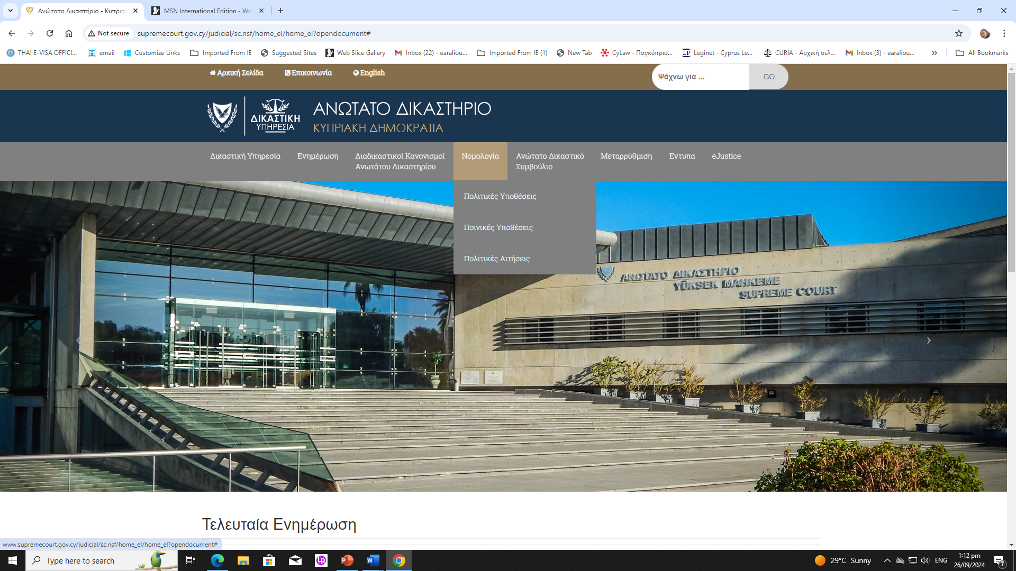
http://www.supremecourt.gov.cy/

Slide 3
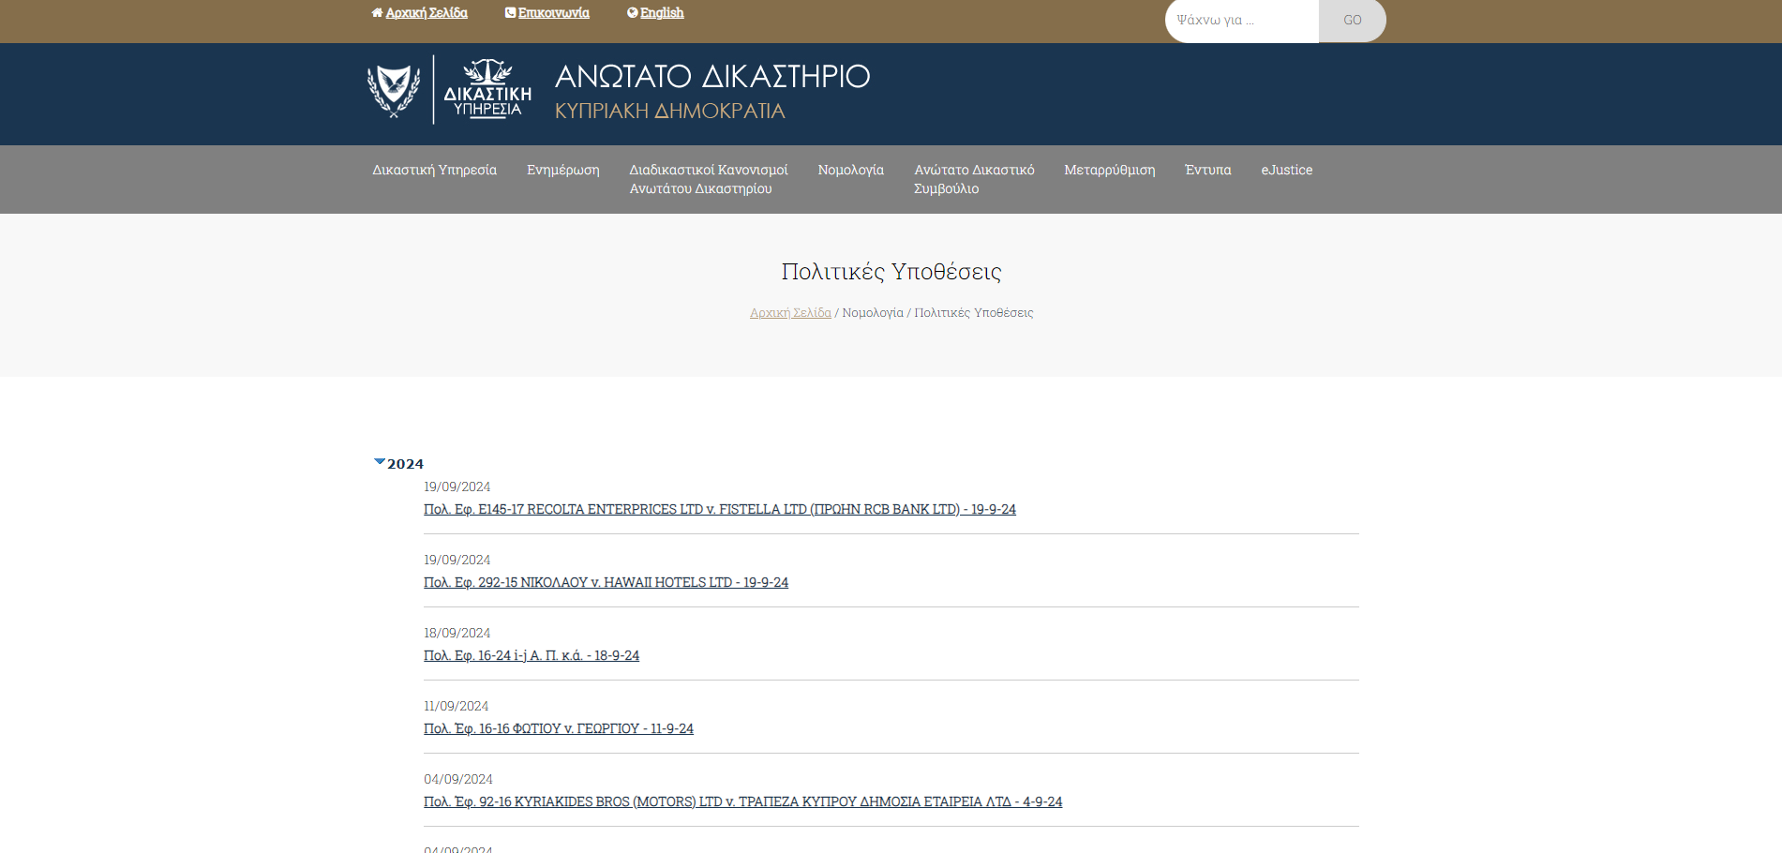
CIVIL/CRIMINAL/APPLICATIONS

Slide 4
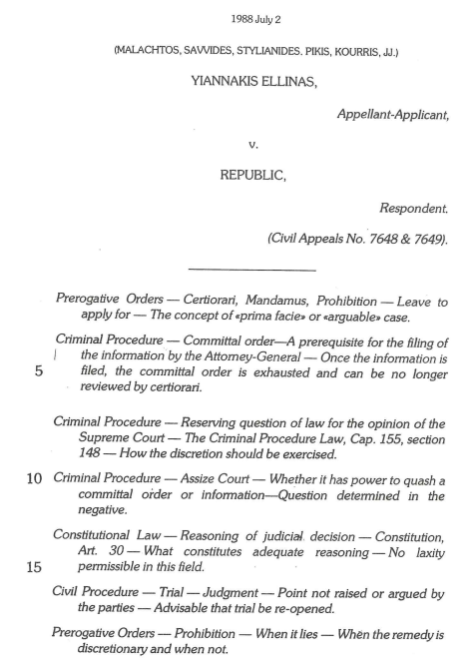
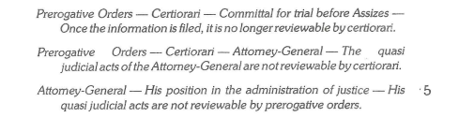
Preface of the published version
1. Rubrics

Slide 5

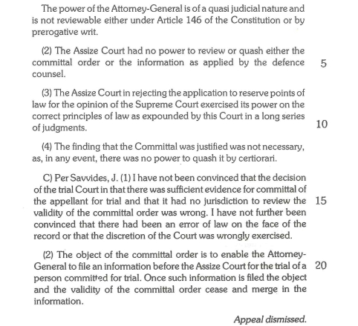
Preface of the published version
2. Summary

Slide 6
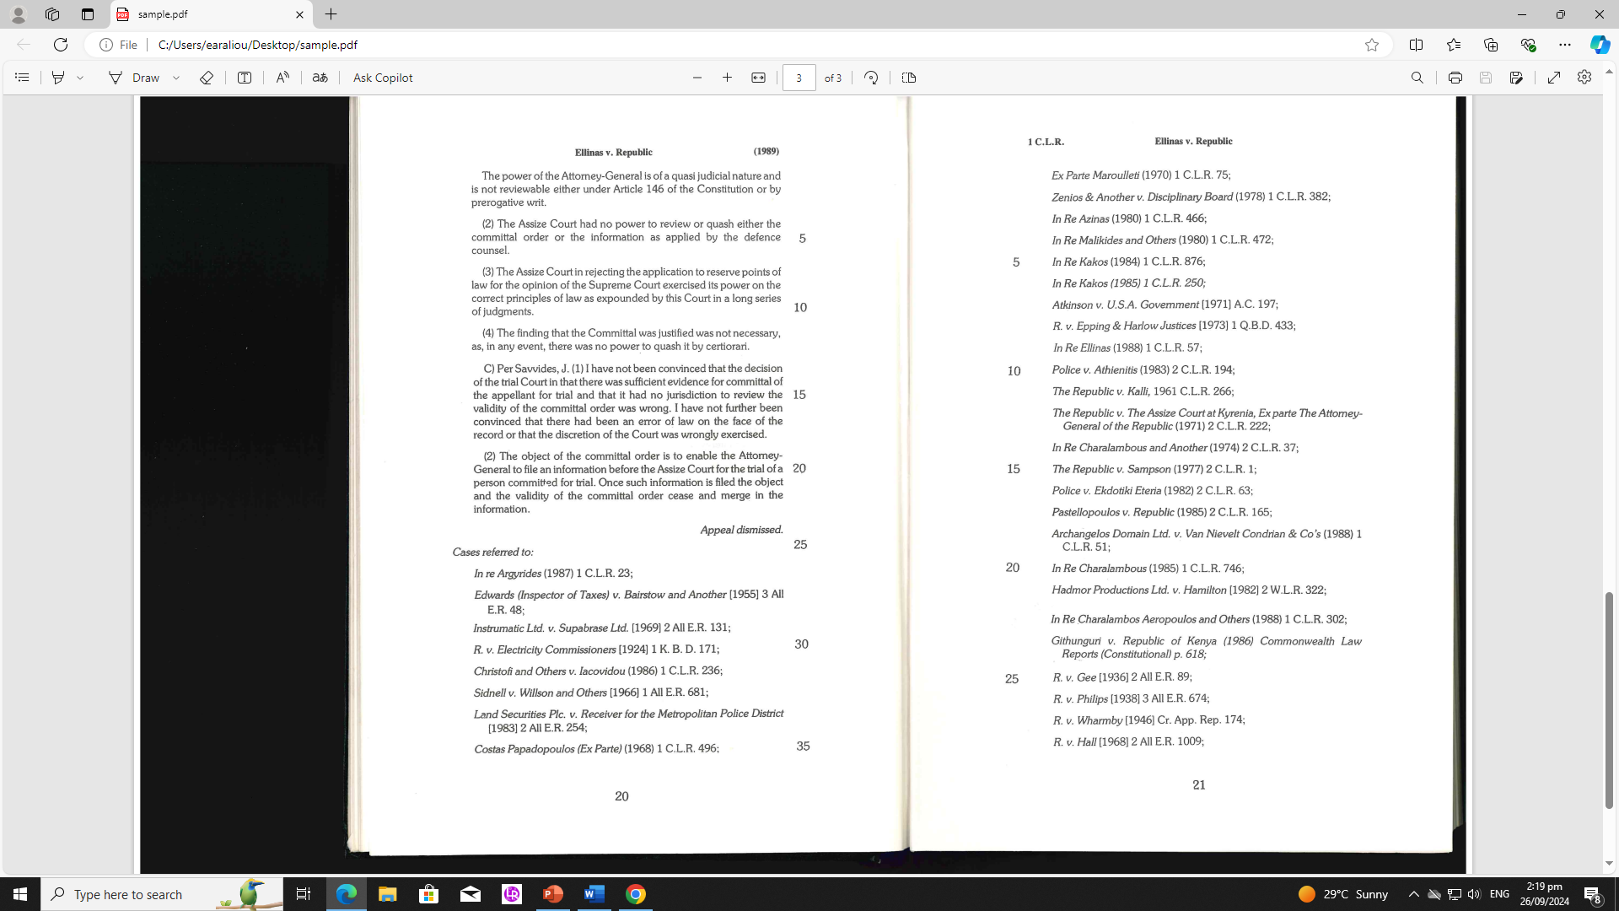
Preface of the published version
3. Referred Cases

Slide 7
New CMS for publishing process
Legal publications Department
-Partial automation/speeding up
-Completion of the formal elements from the decision Pdf document
-Structured fields (rubrics, grounds of appeal, summary)
-Contains updated drop lists (keywords)
-Automated completion of the Cases Index and the Subject index (contents of each volume )

