Slide 1
Finding and Understanding
Visual law, Accessibility, and
Emerging Technologies
Sara Frug
Co-Director, LII

Slide 2
Background

Slide 3
Background
The future is already here -
it’s just not evenly distributed.
- William Gibson

Slide 4
Visual law: Information design-informed questions
Our users:
- Who are they?
- What do they want or need to know?
- What do they want to achieve? in which situation?
How can we make content and documents as:
Clear
Engaging
Accessible
as possible?

Slide 5
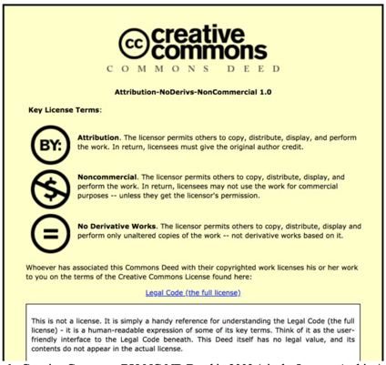
Visual law: Information design-informed questions
Creative Commons BY-NC-ND Deed in 2003 (via the Internet Archive)

Slide 6
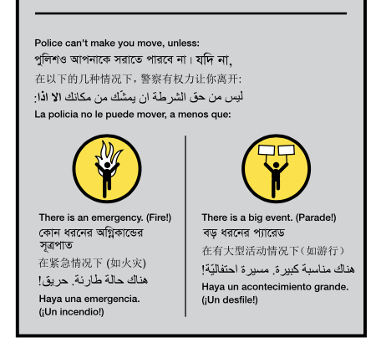
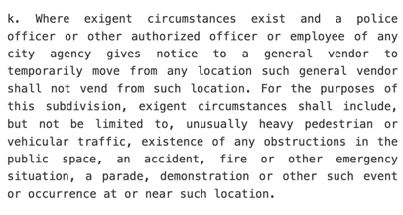
Visual law: Information design-informed questions
Source: New York City Administrative Code
Source: Vendor Power pamphlet
https://welcometocup.org/projects/vendor-power

Slide 7
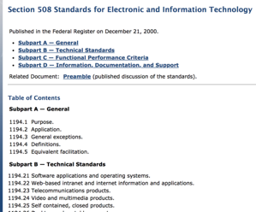
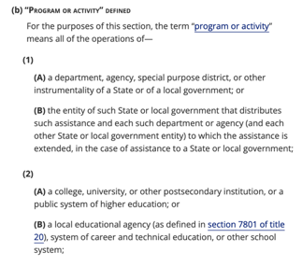
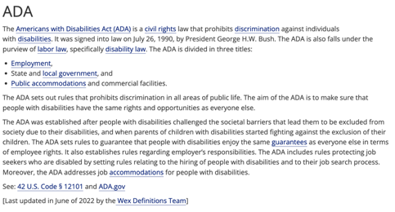
Accessibility: 2019
Section 508
Section 504

Slide 8
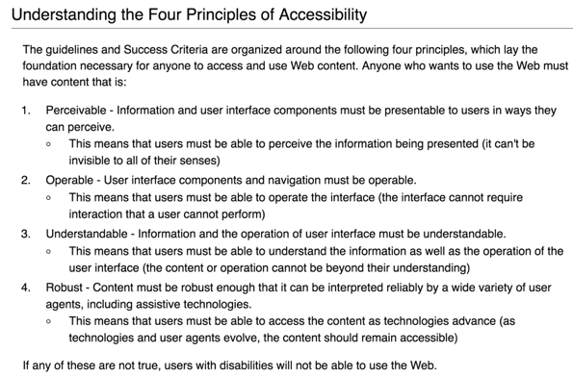
Web Accessibility: Nuts and Bolts

Slide 9
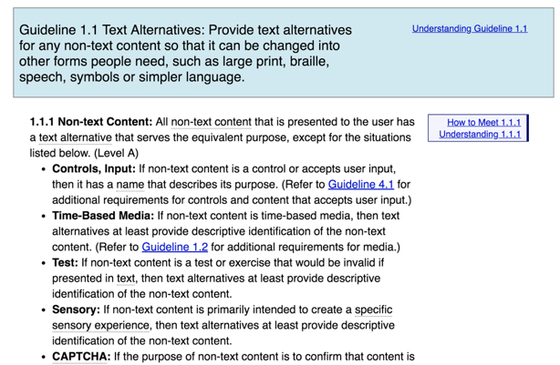
Web Accessibility: Nuts and Bolts

Slide 10
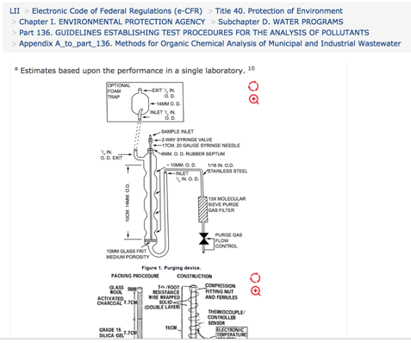
Accessibility
Math
Diagrams
Maps
Forms
Tables
Labels
Logos

Slide 11
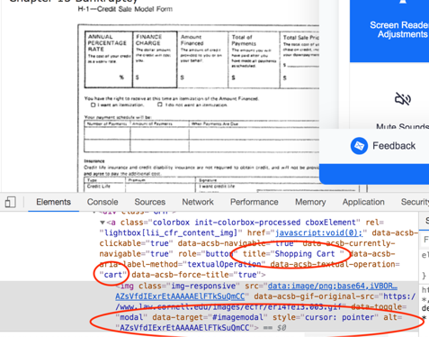
Accessibility: 2019

Slide 12
Universal Design
Equitable
Flexible
Simple and intuitive
Perceptible
Tolerance for error
Low effort
Size and space for approach and use

Slide 13
Emerging technologies
Summarization
Synthesis
Simplification
Interpretation
Translation
Formalization
Perspective

Slide 14
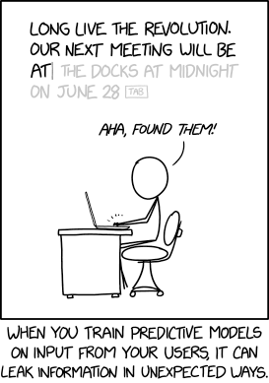
Emerging Technologies: Cautions
Source: XKCD 3169 https://xkcd.com/2169/

Slide 15
Emerging Technologies: Cautions
Source: Exelon Three Mile Island Nuclear Generating Station (cropped).jpg - CC-BY-SA-4.0

Slide 16
Emerging Technologies: Cautions

Slide 17
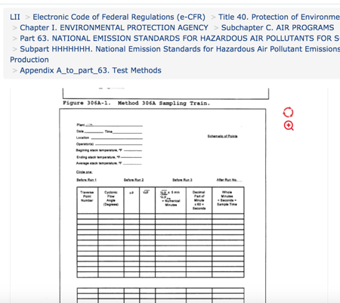
Web Accessibility: Survey: Forms

Slide 18
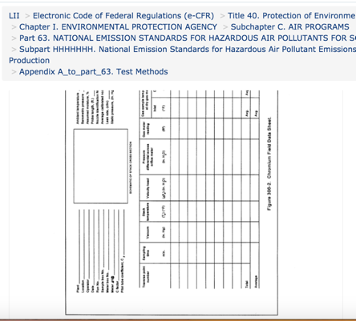
Web Accessibility: Survey: Forms

Slide 19
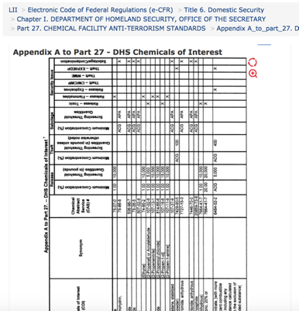
Web Accessibility: Survey: Tables

Slide 20
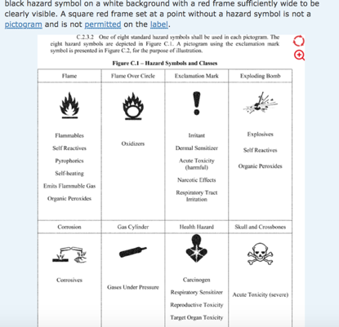
Web Accessibility: Survey: Tables

Slide 21
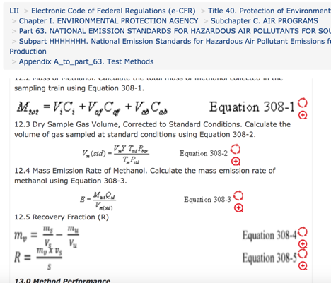
Web Accessibility: Survey: Math

Slide 22
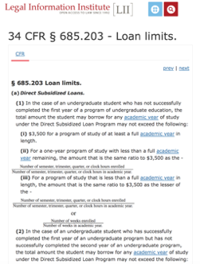
Web Accessibility: Survey: Math

Slide 23
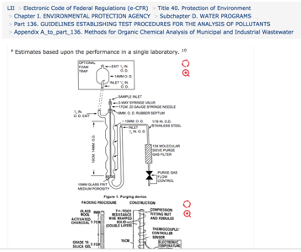
Web Accessibility: Survey: Diagrams

Slide 24
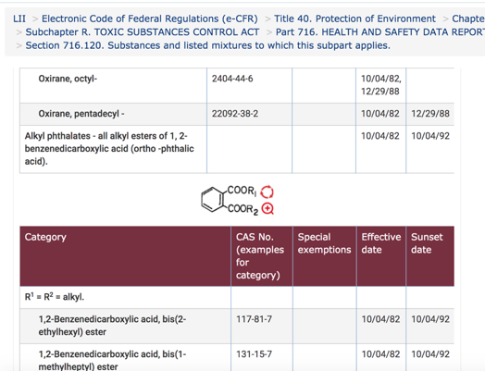
Web Accessibility: Survey: Diagrams

Slide 25
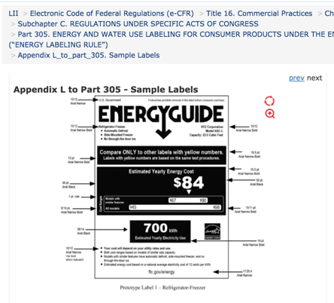
Web Accessibility: Survey: Labels

Slide 26
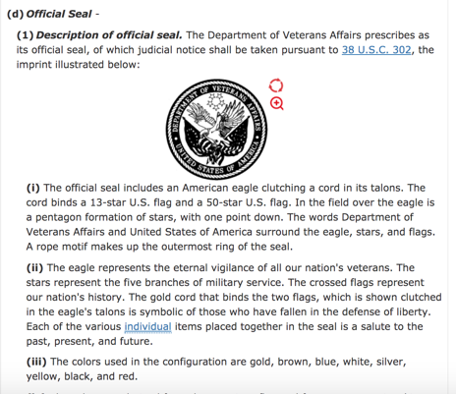
Web Accessibility: Survey: Logos

Slide 27
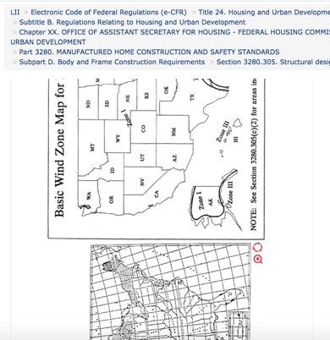
Web Accessibility: Survey: Maps

Slide 28
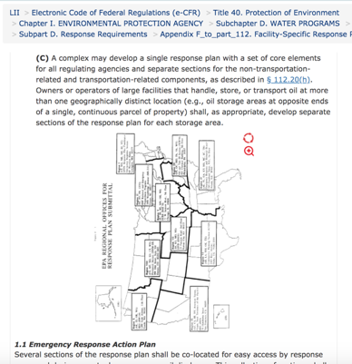
Web Accessibility: Survey: Maps

Slide 29
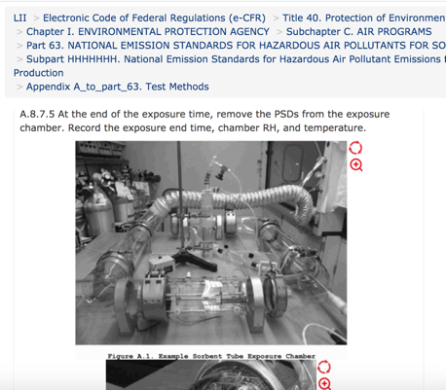
Web Accessibility: Survey: “Difficult”

Slide 30
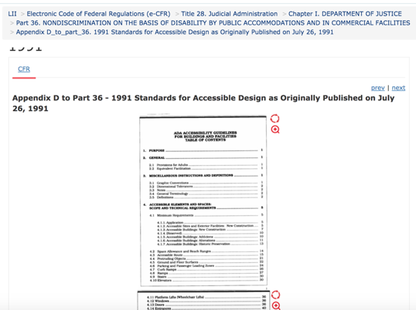
Web Accessibility: Survey: and our favorite...

Slide 31
Web Accessibility: Survey: and our favorite...

Slide 32
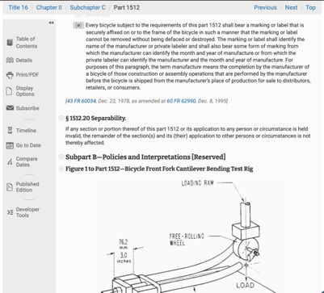
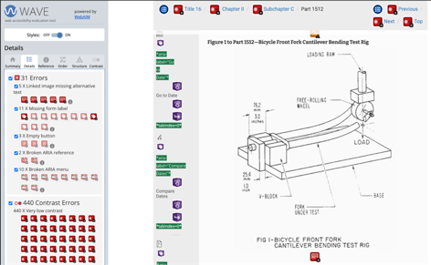
Accessibility: 2024
Source: ecfr.gov

Slide 33
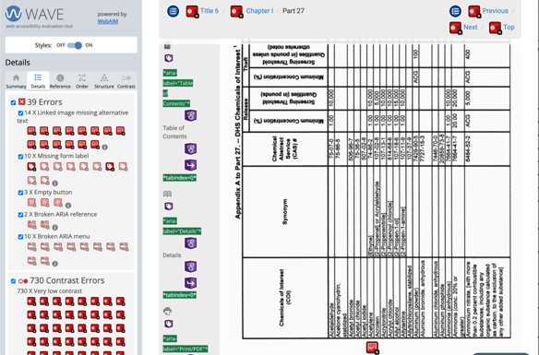
Accessibility: 2024
Source: ecfr.gov

Slide 34
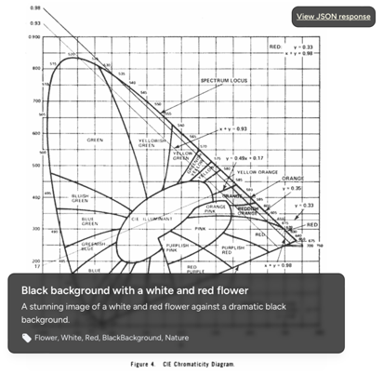
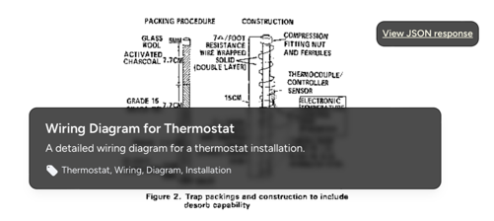
Accessibility: 2024

Slide 35
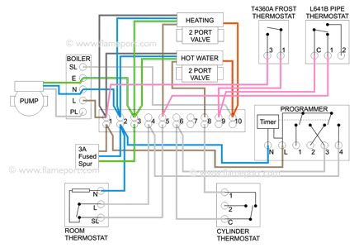
Accessibility: 2024
Source: https://flameport.com/electric/central_heating/heating_wiring_frost_thermostats.cs4

Slide 36
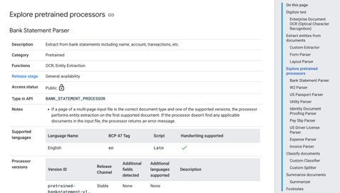
Accessibility: 2024
Bank statement
W2
US passport
Utility bill
Identity document
Pay slip
US Driver’s license
Expense
Invoice
Source: Google Vision / Document AI

Slide 37
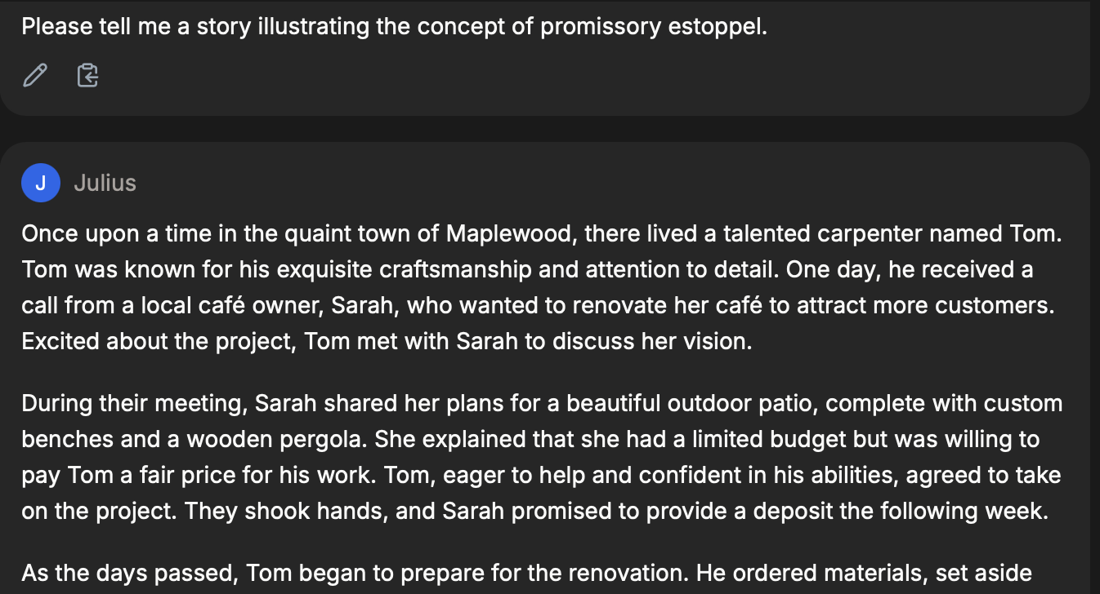
Language tools

Slide 38
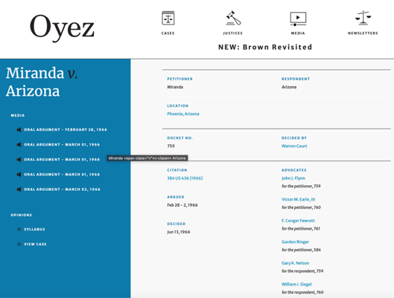
Sound: Historical recordings
Source: Oyez.org

Slide 39
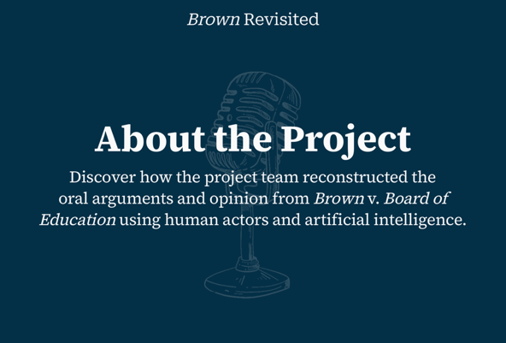
Sound: Voice print: Brown Revisited
Source: brown.oyez.org

Slide 40
Visual: Lip sync
U.S. Supreme Court art project
Source: https://grail.cs.washington.edu/projects/AudioToObama/
Source: LII / Cornell MEng project, Kriti Sinha

Slide 41
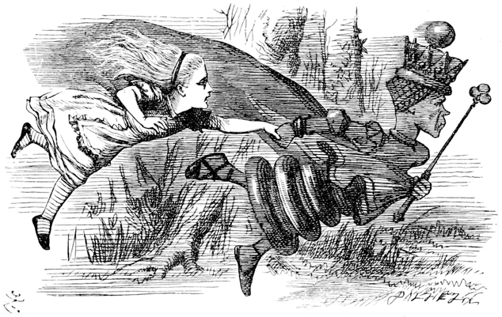
Distributing the Future

Slide 42
Thank you!
Questions?
sara.frug@cornell.edu

