Slide 1
Lexum’s AI-Powered Legal Information Analysis: The Kitten Play Is Over
Pierre-Paul Lemyre
VP Business Development
September 26, 2024

Slide 2
Twelve months ago in a galaxy far, far away…
1

Slide 3
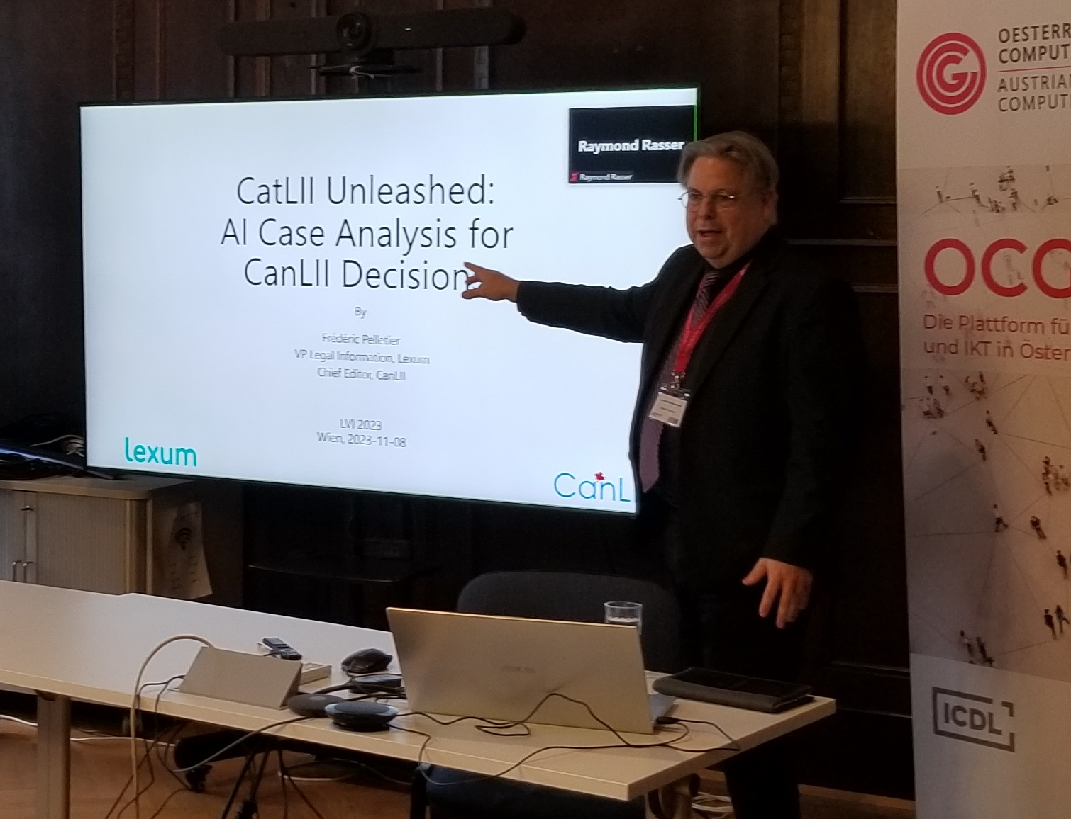
CatLII Was Unleashed!

Slide 4

CatLII Pilot Project
Testing LLM for AI case analysis
    ˜400 decisions
    From 4 jurisdictions
    Via CanLII Connects
Setup of Lexum’s AI Playground
    Upload content from CanLII
    Test prompts, LLM providers and releases
    Keep a record of those tests
Gather user feedback
“Preserve CanLII’s reputation!”

Slide 5
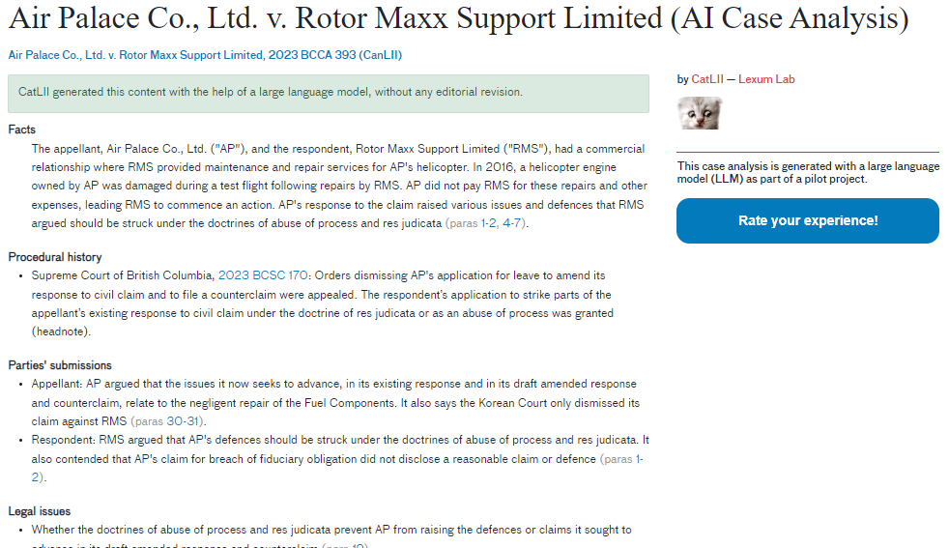

Slide 6
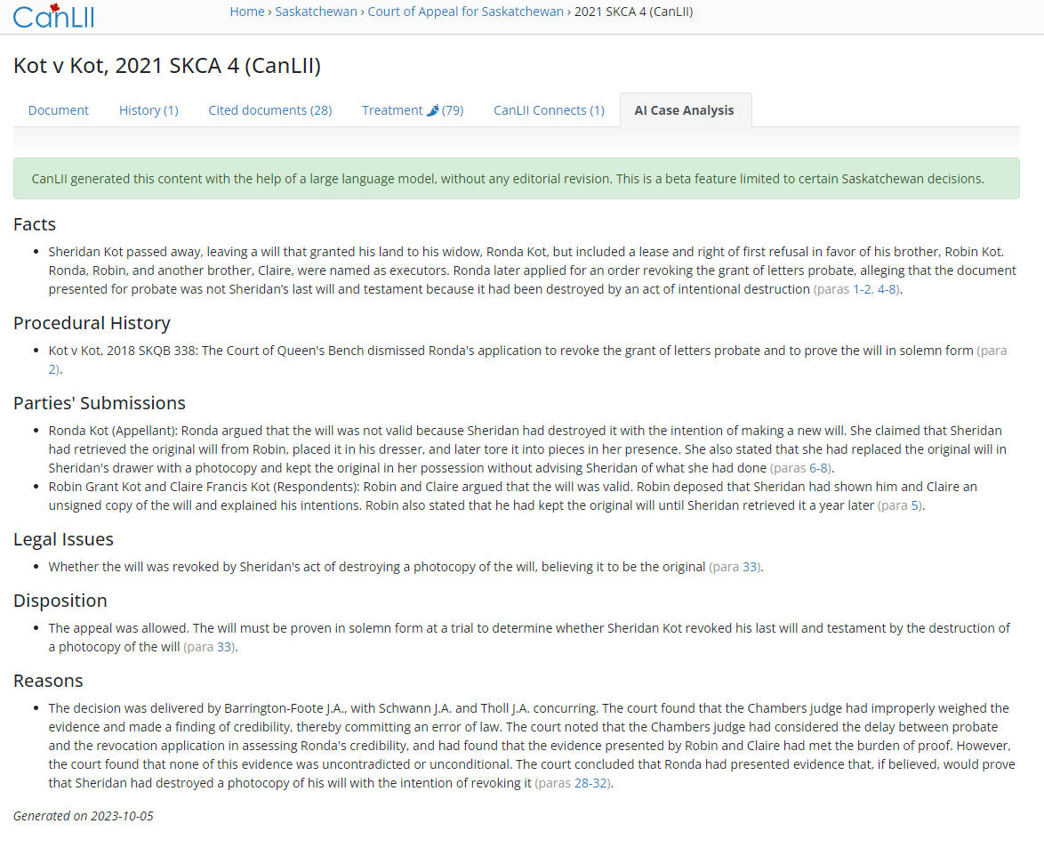
The Vibes Were Good
Law Foundation of Saskatchewan Beta
    First official project
    Funded the production infrastructure
    Launched October 2023
    With current case law only
Lots of other ideas
    Other types of automatically generated outputs
    AI analysis for legislation
    Automated translation
    Conversational search
    …

Slide 7
Where Do We Stand Now?
2

Slide 8




7 Provinces and Counting
Saskatchewan
    60,000 case summaries (99%)
    + 4,000/year
Alberta
    121,000 case summaries (99%)
    + 7,000/year
Manitoba
    28,000 case summaries (98%)
    + 1,500/year
Prince Edward Island
    4,000 case summaries (97%)
    + 100/year

Slide 9



7 Provinces and Counting
New Brunswick
    43,200 case summaries (92%)
    + 900/year
    Lower completion rate due to a large volume of very short decisions
    First significant volume of French cases (8,000)
Newfoundland and Labrador
    14,000 case summaries (99,5%)
    + 450/year
Northwest Territories
    12,000 case summaries (99%)
    + 350/year

Slide 10


2 More on the Way
Ontario
    65,000 case summaries (aiming at 9% this year)
    + 6,000 / year
Quebec
    500,000 case summaries (aiming at 30% this year)
    + 28,000 / year

Slide 11
Legislative Summaries
Consolidated statutes & regulations
4 Provinces deployed
    Alberta (2,500 documents)
    Saskatchewan (2,700 documents)
    Manitoba (2,500 documents x 2 languages)
    Prince Edward Island (1,000 documents)
5 more on the way
    New Brunswick (1,600 documents x 2 languages)
    Newfoundland and Labrador (2,900 documents)
    Northwest Territories (1,120 documents)
    Ontario (2,570 documents x 2 languages)
    Quebec (7,150 documents x 2 languages)

Slide 12
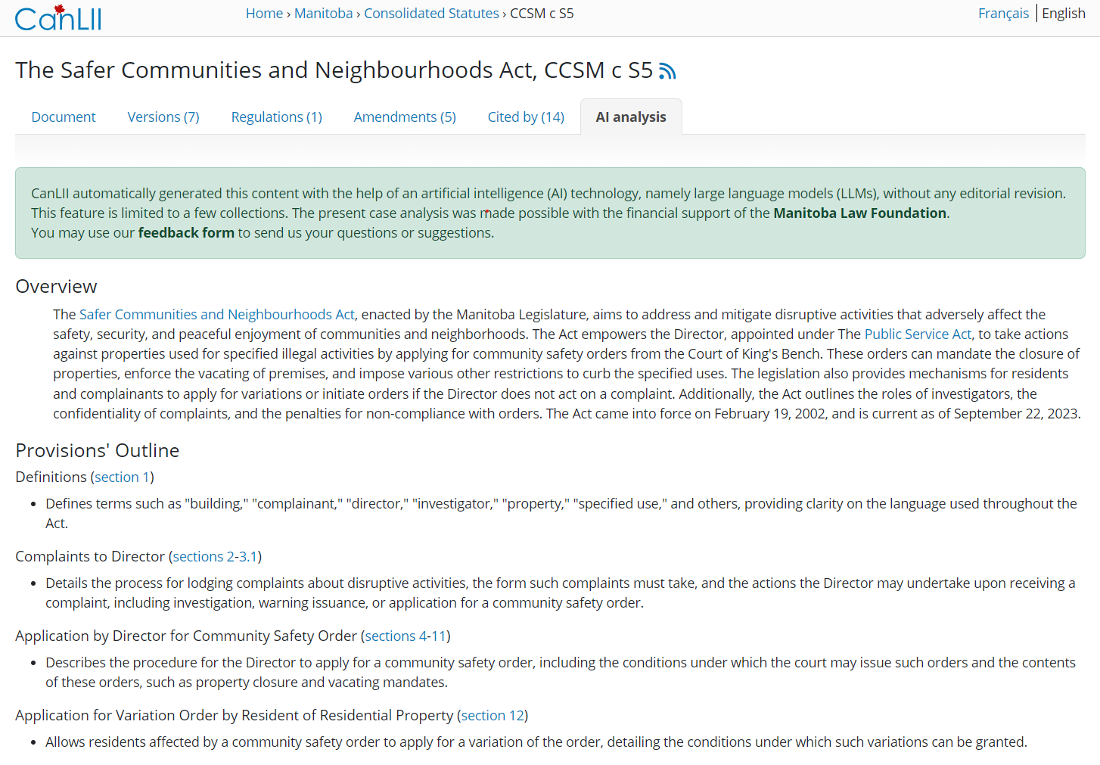

Slide 13
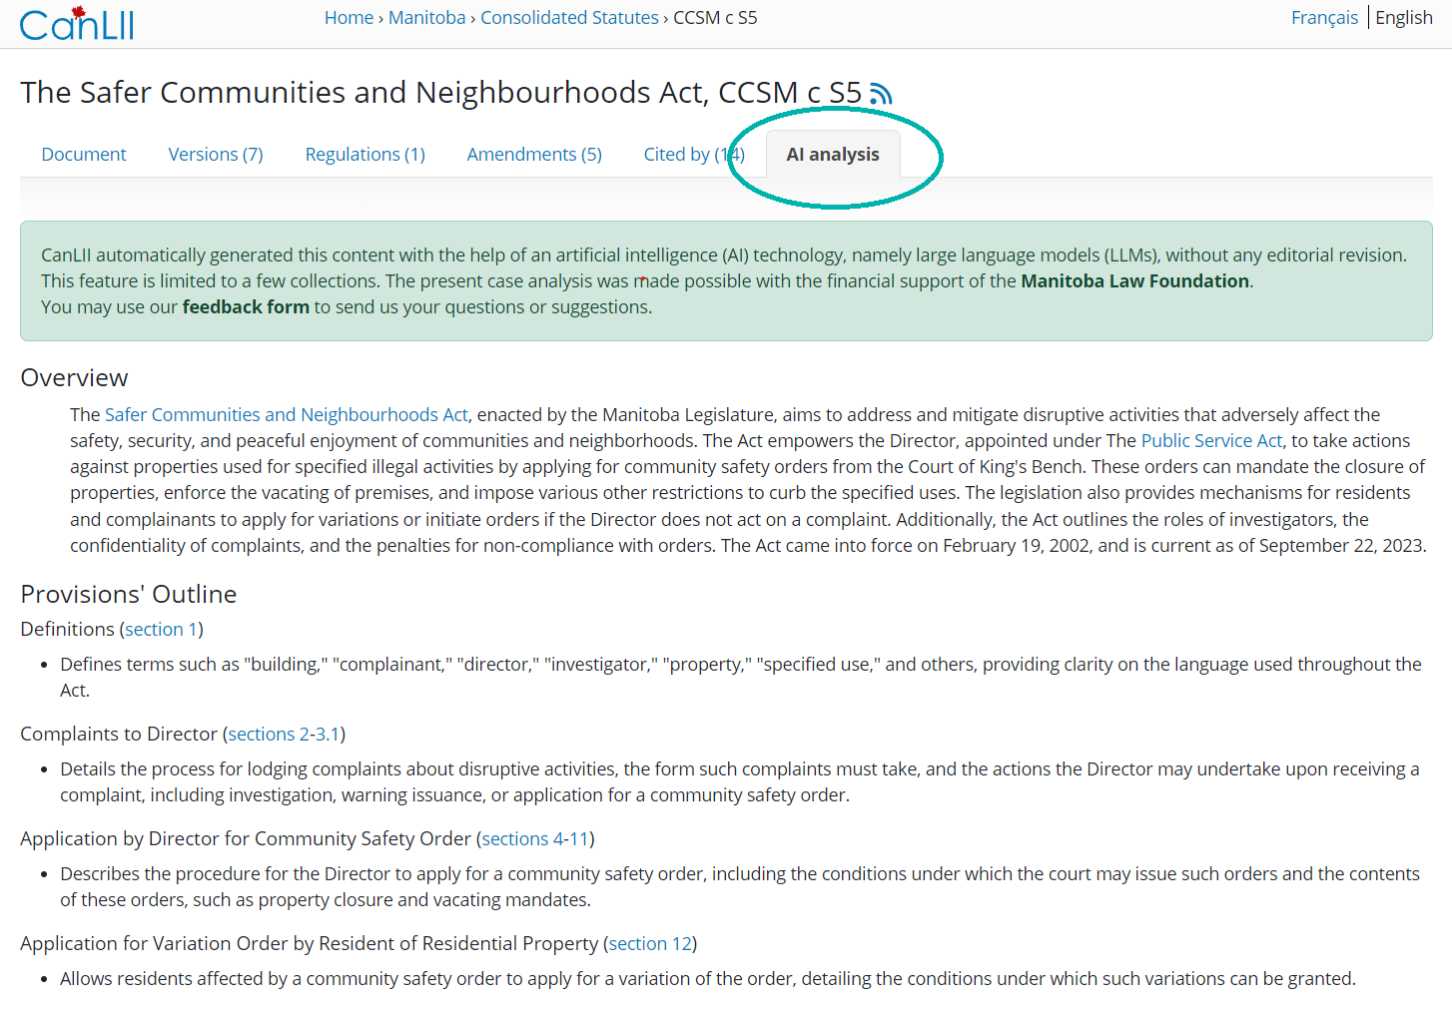

Slide 14
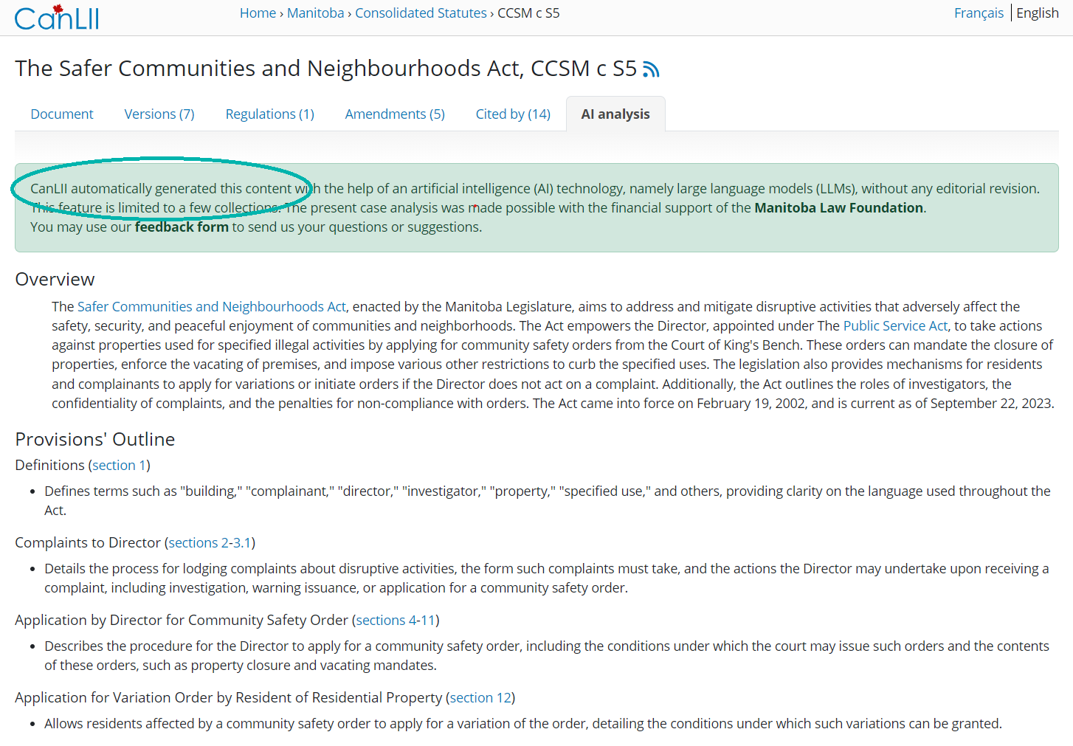

Slide 15
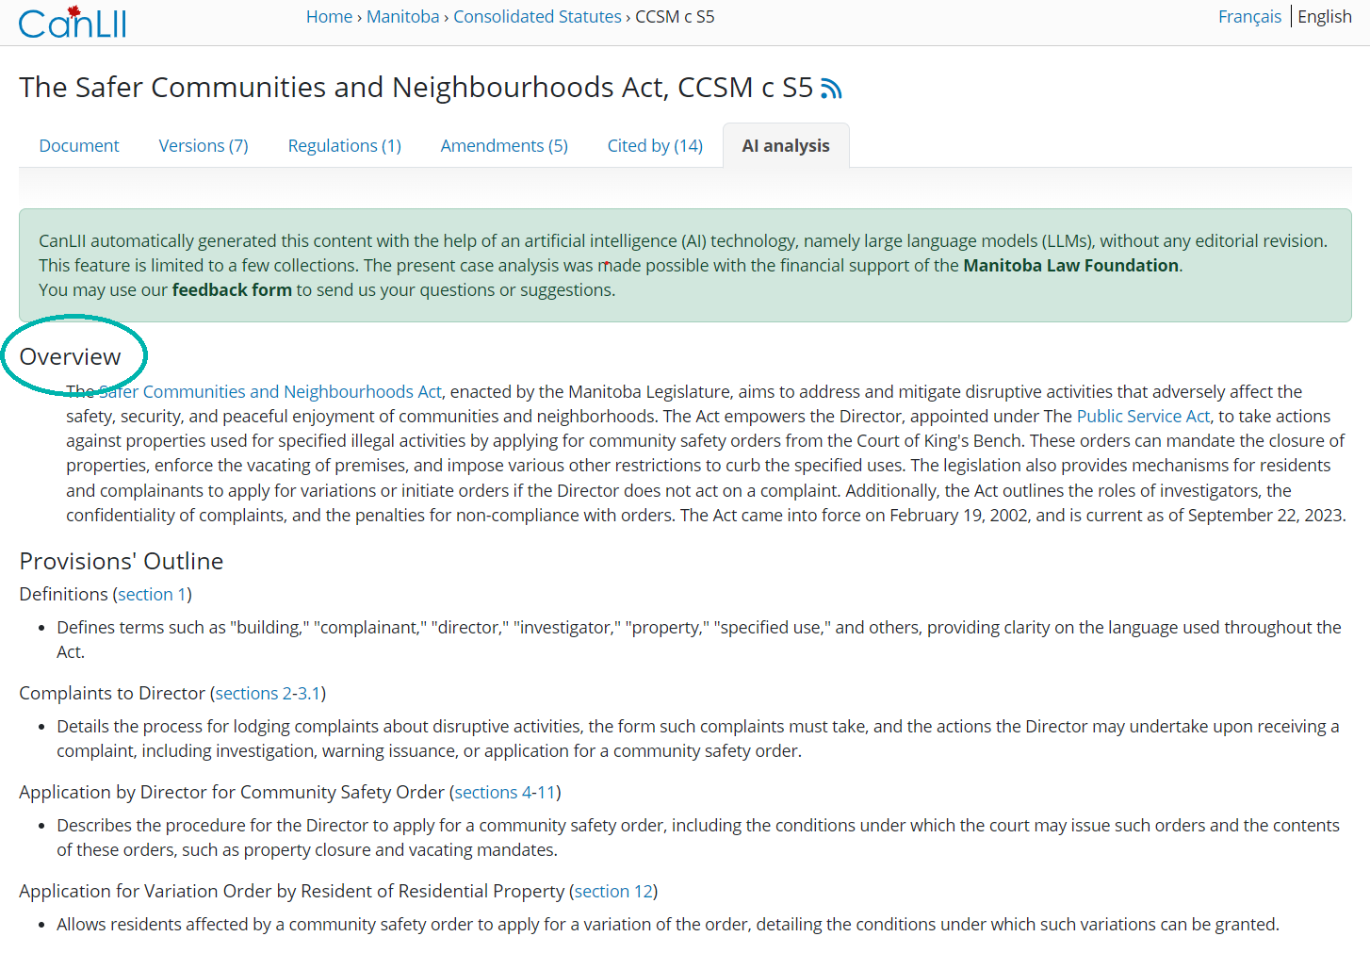

Slide 16
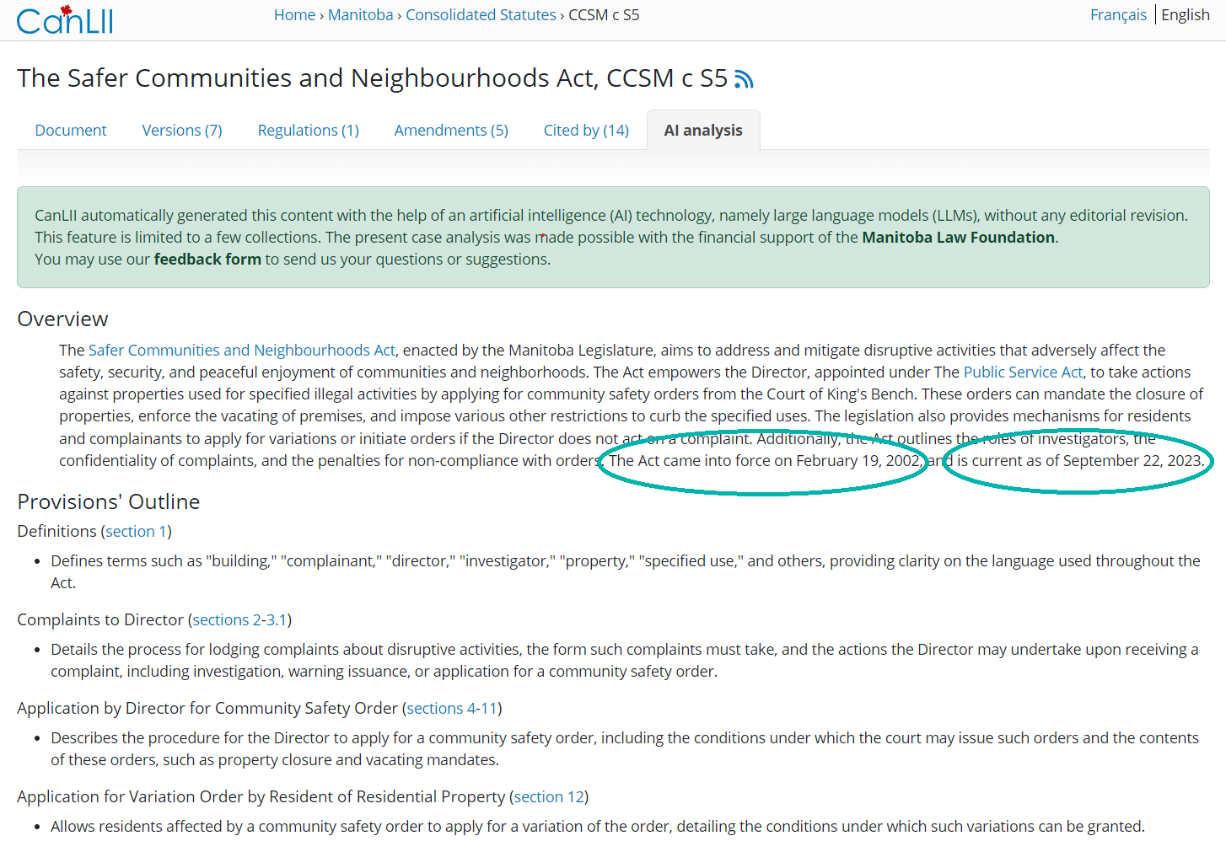

Slide 17
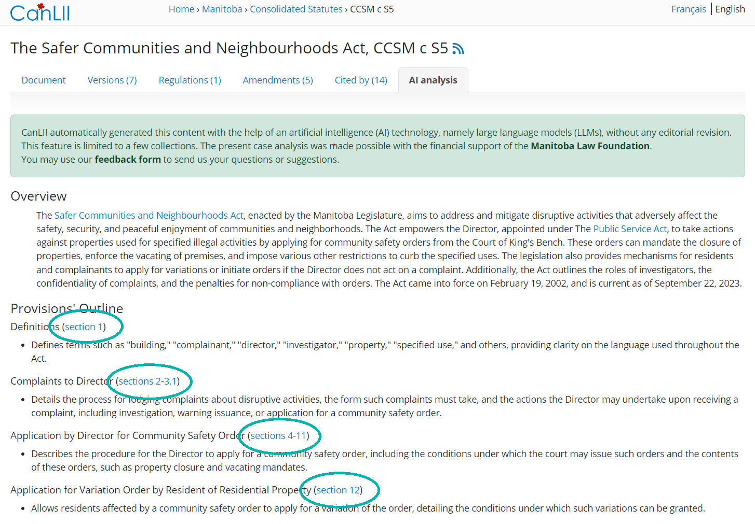

Slide 18
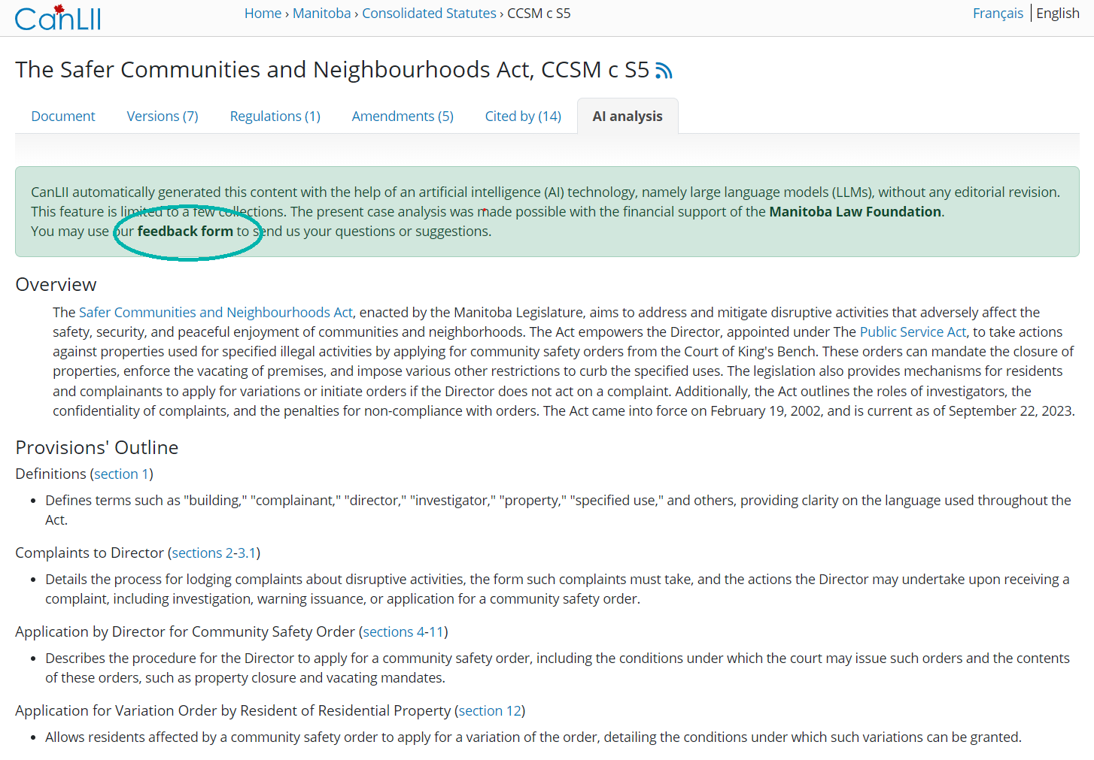

Slide 19



Outside of CanLII
AI-powered enrichments now available via Decisia
    Triggered on-demand by editors
    Leverage “Summary” Field (best) or separate document
    Can be reviewed/edited before posting
Early adopters
    New Mexico Compilation Commission
    Nova Scotia Courts
    Canada Copyright Board

Slide 20
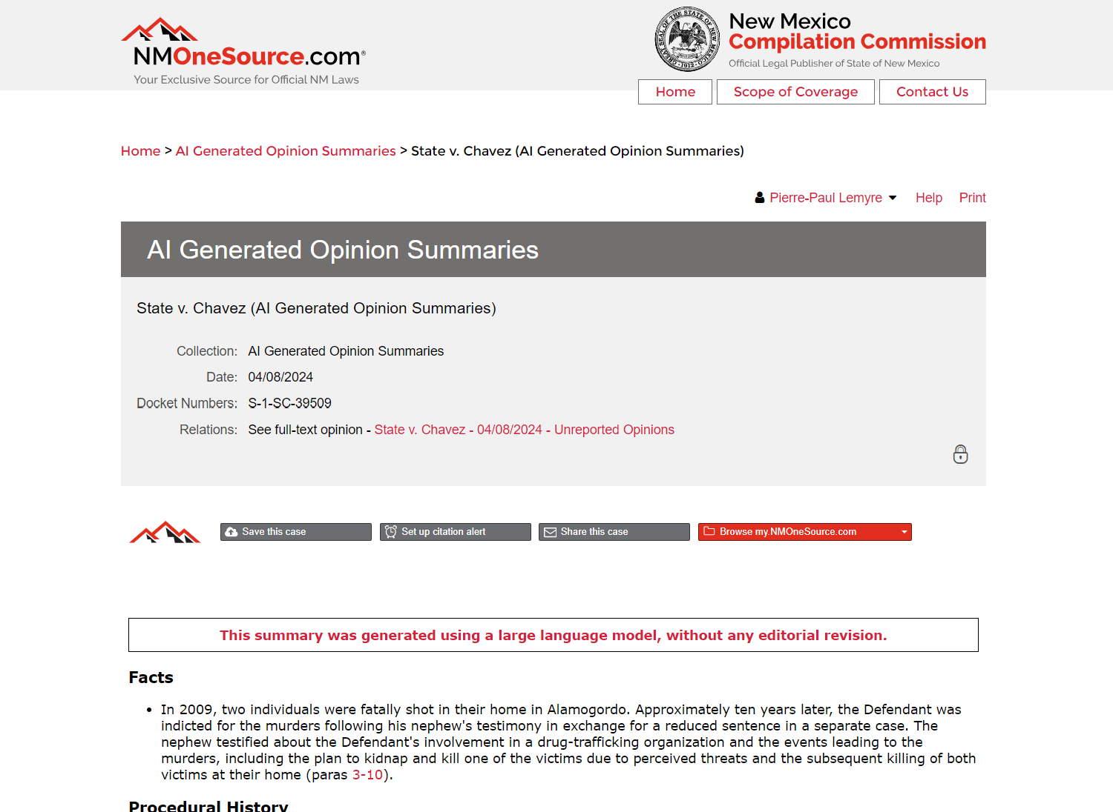

Slide 21
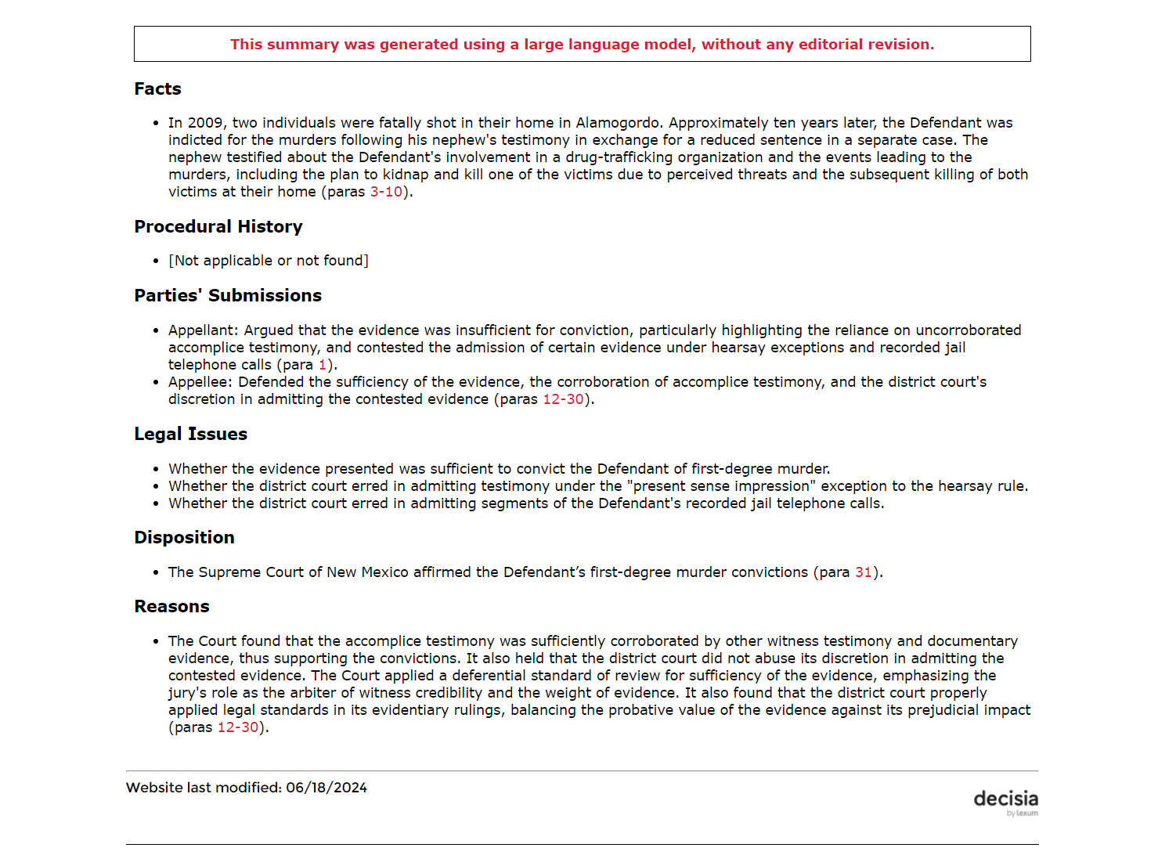

Slide 22
Challenges & Opportunities
3

Slide 23
Success Rate?
We are thinking completion rate
    % of documents enriched
They are thinking accuracy rate
    % of correct enrichments
Inquiries by donors, the media, prospects…
    Feedback is positive, but how positive?
Upcoming Canadian national impact assessment

Slide 24
Expectations About "Explainability"
Reluctance to adopt
    Out of fear of bias, discrimination, etc.
    Out of incapacity to explain the reasoning
    Request for “non-citable” waiver in the US
Directing users to sources via dynamic linking
Ethical, legal and political framework for the use of technology in preparation
    To be made available publicly

Slide 25
Expectations About Data Security
Privacy of parties involved in cases
    LLM training on cases could jeopardize data sources
Security of legal researchers' data
    Going beyond static enrichments requires user accounts
      To keep track of context
      To bill costs incurred from LLM
    Legal research history can be privileged information
SOC2 or ISO 27001

Slide 26
Requests for Customization
On CanLII, uniformity is a gage of quality
Other clients want to distinguish themselves
    Existing added value format (man-made summaries, classification, …)
    Level of language
    Focus on specific issues (ex: copyright tariff)
New custom prompting services
    Custom enrichments
    Metadata extraction
    In-house workflow support

Slide 27
Appetite for Translations
Canadian federal institutions will soon need to publish English and French versions at the same time
    That means no access before the translation is available…
Can we use LLM to translate legal information?
    High standard for official versions
    Imperfect quality generate fear of inequality among linguistic groups
    Highly sensitive political issue
Focus on AI-Powered enrichments first
    Not official, low risk

Slide 28
Appetite for Additional Enrichments
Short summaries
    200 words blurbs
    To provide context in search results
Meaningful titles
    Alternative titles for case law instead of parties’ names
Classification
    Grouping into fields of law
    Replacing a legacy AI algorithm
Keywords
    Extracting the most significant words from the document
    Replacing a legacy AI algorithm

Slide 29
What’s Ahead?
4

Slide 30
National Impact Assesment
Evaluating outcomes
    Do AI-Powered Enrichments facilitate your understanding of the law?
    Do they speed up your legal research?
Funded by the Alberta Law Foundation
    Oct-Dec 2024
    Online survey on canlii.org
    In-person interviews
    Legal professionals + public

Slide 31
Bilingual Enrichments
AI-powered enrichments in the second language for all supported content
    Generation in second language (no translation)
    Quality control by an expert jurilinguist
Indexing of enrichments by the search engine
    All Canadian law could be discoverable in both languages for the first time ever
Law Foundation of Saskatchewan is onboard so far

Slide 32
Federal Material
AI-powered Enrichments for
    Historical case law (230,000 documents)
    Consolidated statutes and regulations (5,900 documents)
    Current material for the next three years (˜12,000 documents per year)
    271,900 x 2 languages = 543,800 documents
Split among law foundations based on the province’s contribution to CanLII

Slide 33
Generation Augmented Retrieval (GAR)
RAG > GAR
    Focus on Retrieval instead of Generation
Chatbot supporting legal research
    Interprets user query
    Proposes improvements
    Reads top results
    Provides research memo
Early access MVP by mid-2025

Slide 34
To Learn More
Canadian Lawyer Magazine
    Lexum Pilot Project Using AI to Summarize Cases Expands to Alberta, Manitoba and PEI
Lexum Blog
    AI-powered Case Analysis Added on CanLII for All Case Law From Alberta, Saskatchewan, Manitoba, and Prince Edward Island
    Lexum Extends its AI Enrichment Services to Legislative Material
Pierre-Paul Lemyre
VP Business Development
lemyrep@lexum.com
514.316.2098

