Slide 1
AI Copyright Litigation in the United States
2024 Update
Notes:
1

Slide 2
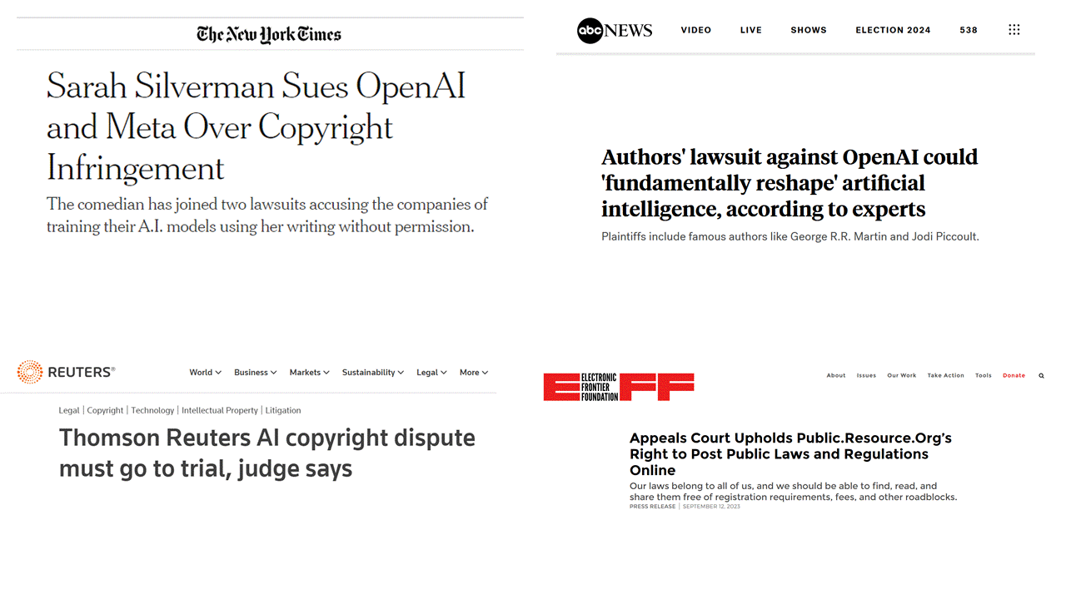
Notes:
2
Last year in Vienna, I talked about American Copyright Law, specifically the copyright infringement defense of Fair Use and the role of a concept called Transformative Use as an increasingly-popular tool American courts are relying on when determining whether the Fair Use defense excuses copying.
I started last year with this very slide, explaining that these four cases were among those most likely to impact how we can create better ways of putting legal information online.
And based on the questions I answered and the conversations I had about it for the rest of the conference, I felt there was a fair amount of interest in the topic. So I offered to come back this year with an update based on what has happened in this area of American law since we last met in November.
Parts of this talk are repeated from last year. If you are one of the handful of people who saw my talk last year and have amazing recall such that you’ll be bored by some repetition, I do apologize.

Slide 3
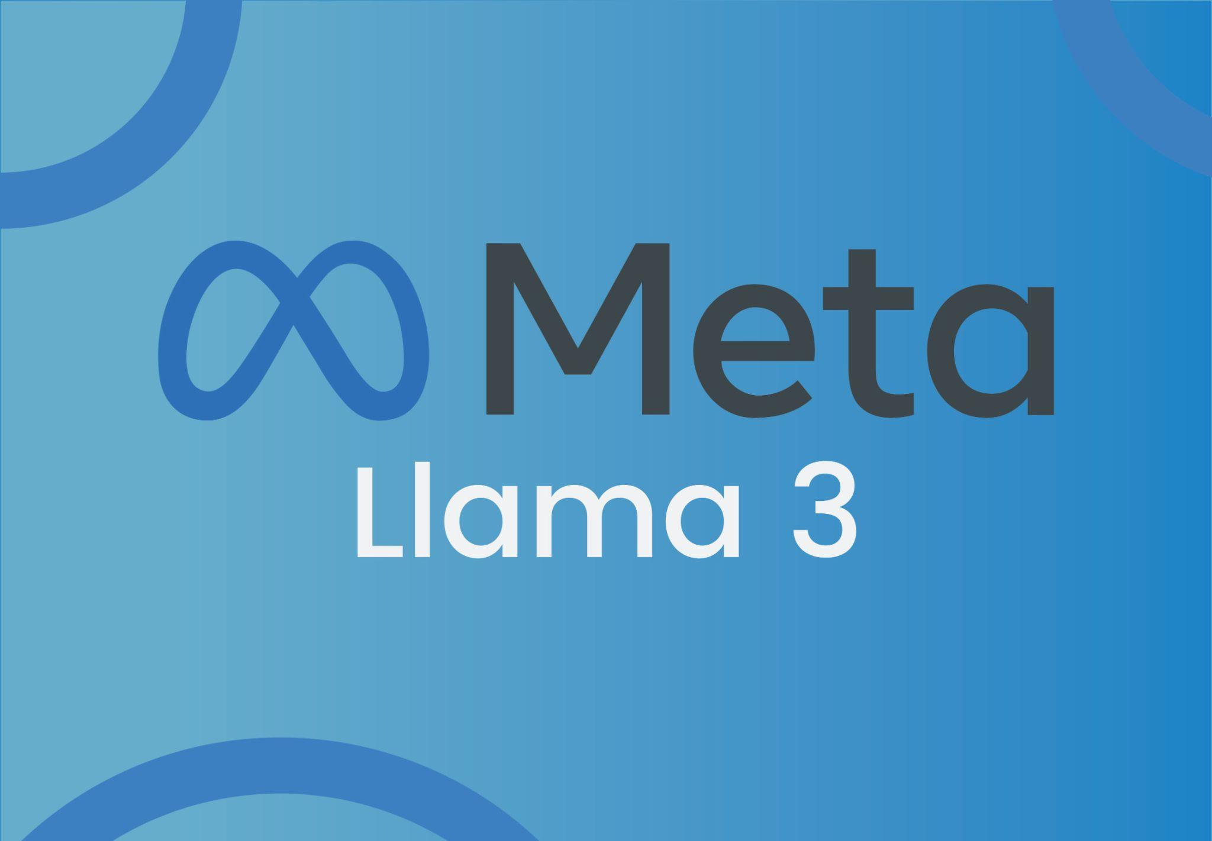
Notes:
3
I wouldn’t ordinarily bother an international audience with a presentation about American law. However, this topic is rather different because it’s quite likely that how these cases play out will impact the general purpose commercial AI market, which we’ll get to before I’m through with this talk.
And this is really the first sort of odd or unusual thing I want to point out: originally this slide had not only Llama and ChatGPT on it, but also Google’s Gemini AI. Does anyone want to make a guess why this slide doesn’t have Google Gemini on it?
Because, as best I can tell, no one has sued Gemini in the US for copyright infringement. As someone who used to represent giant companies like this, and without disclosing too much I’ll say “giant companies EXACTLY like this” (wink, wink) this is fascinating to me.
I will note that France’s competition authority fined Google 250 million Euros in March for allegedly violating agreements Google had reached regarding the use of protected content from French publishers and press agencies for training Gemini’s predecessor Bard. And I’ll also note that legislators and regulators in many countries represented at this conference such as Canada, Australia, and the UK seem keenly aware of this issue in general, and Google’s role in specific.
So while I’m not the right person to talk to any audience, much less this one, about the lack of transparency in how these systems really work, or more specifically what data the underlying large language models have or have not been trained on, I don’t think it’s controversial to say that no one can really look at the available information and say that there is any line to be drawn on how likely infringement of copyright is to be occurring with some of these platforms and not others.
So why haven’t American authors, publishers, news outlets, etc. come after Google in American courts the way they have Meta and OpenAI/Microsoft? I have a theory, but I won’t share it quite yet….

Slide 4
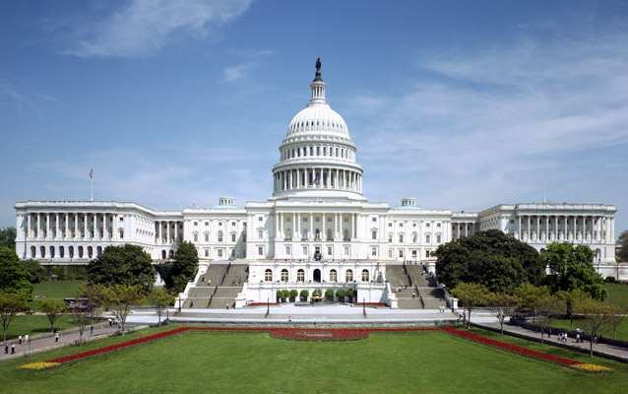
Notes:
4
Let’s start with Fair Use as a defense to allegations of copying material protected by copyright.
The United States Congress, which is our national (or federal) legislature, first codified the fair use doctrine in 1976 in an effort to recognize and standardize what it acknowledged had become one of the most important and well-established defenses to copyright infringement claims. Congress noted that various courts had considered and ruled on fair use defenses with no one definition or test gaining universal adoption and acceptance.
In common law jurisdictions, or at least in the US where I practice law, this happens. Parties to litigation propose novel tests or legal standards or defenses or theories of liability, and sometimes courts adopt them. And then legislatures sometimes step in and either say No we don’t agree with this outcome and we’ll either amend an existing law or pass a new one to clarify what the legal boundaries are; or, they say Yes that seems fine with us and we’re going to codify what the courts have done to clear up any doubt about what the correct outcome should be going forward

Slide 5
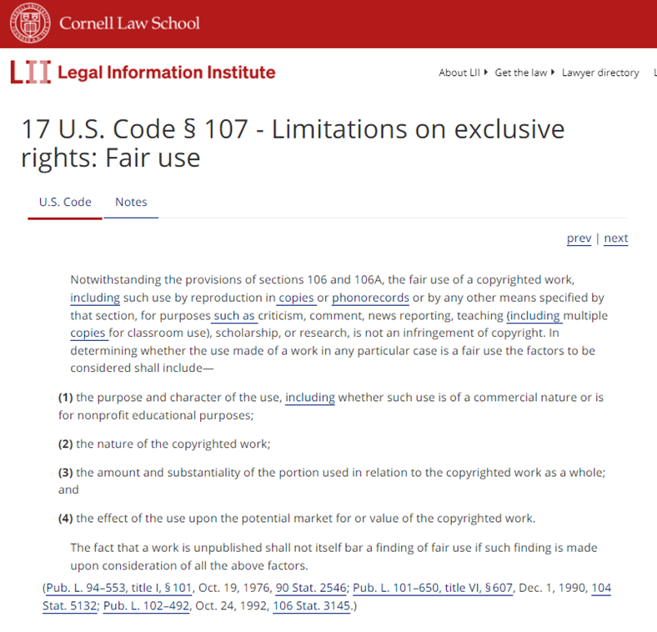
Fair Use
An “affirmative defense” that excuses copying in certain, limited circumstances.
Four-Factor Test (17 U.S.C. § 107):
Purpose & character of use
* “transformative use” *
Nature of the copyrighted work
Amount of the work copied
Effect on the market/value of the protected work
Notes:
5
[click]
Historically, the defense of copyright fair use was closely associated with [click] not-for-profit activities and minimal copying, such as teachers copying a few pages from an article to distribute to their students, or a book review repeating a small amount of copyrighted text in order to discuss the book.
[click] And you see this reflected in the four parts of the fair use test on the left side of this slide, which I’ve extracted from the actual statute [click] which is on the right side, courtesy of our website.
As I said last year, fair use analysis in its simplest form has historically attempted to determine if the infringer was receiving money that should have gone to the copyright holder. If the answer was no, not really, then fair use!

Slide 6
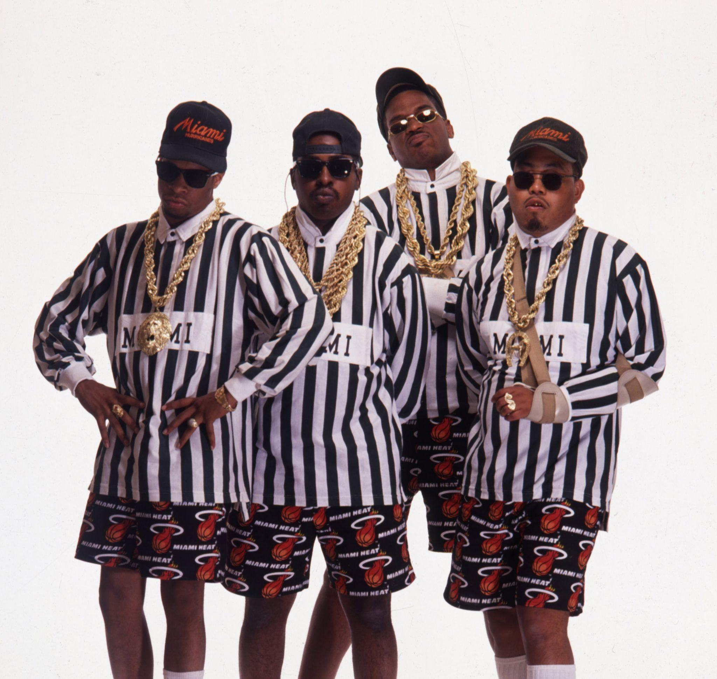
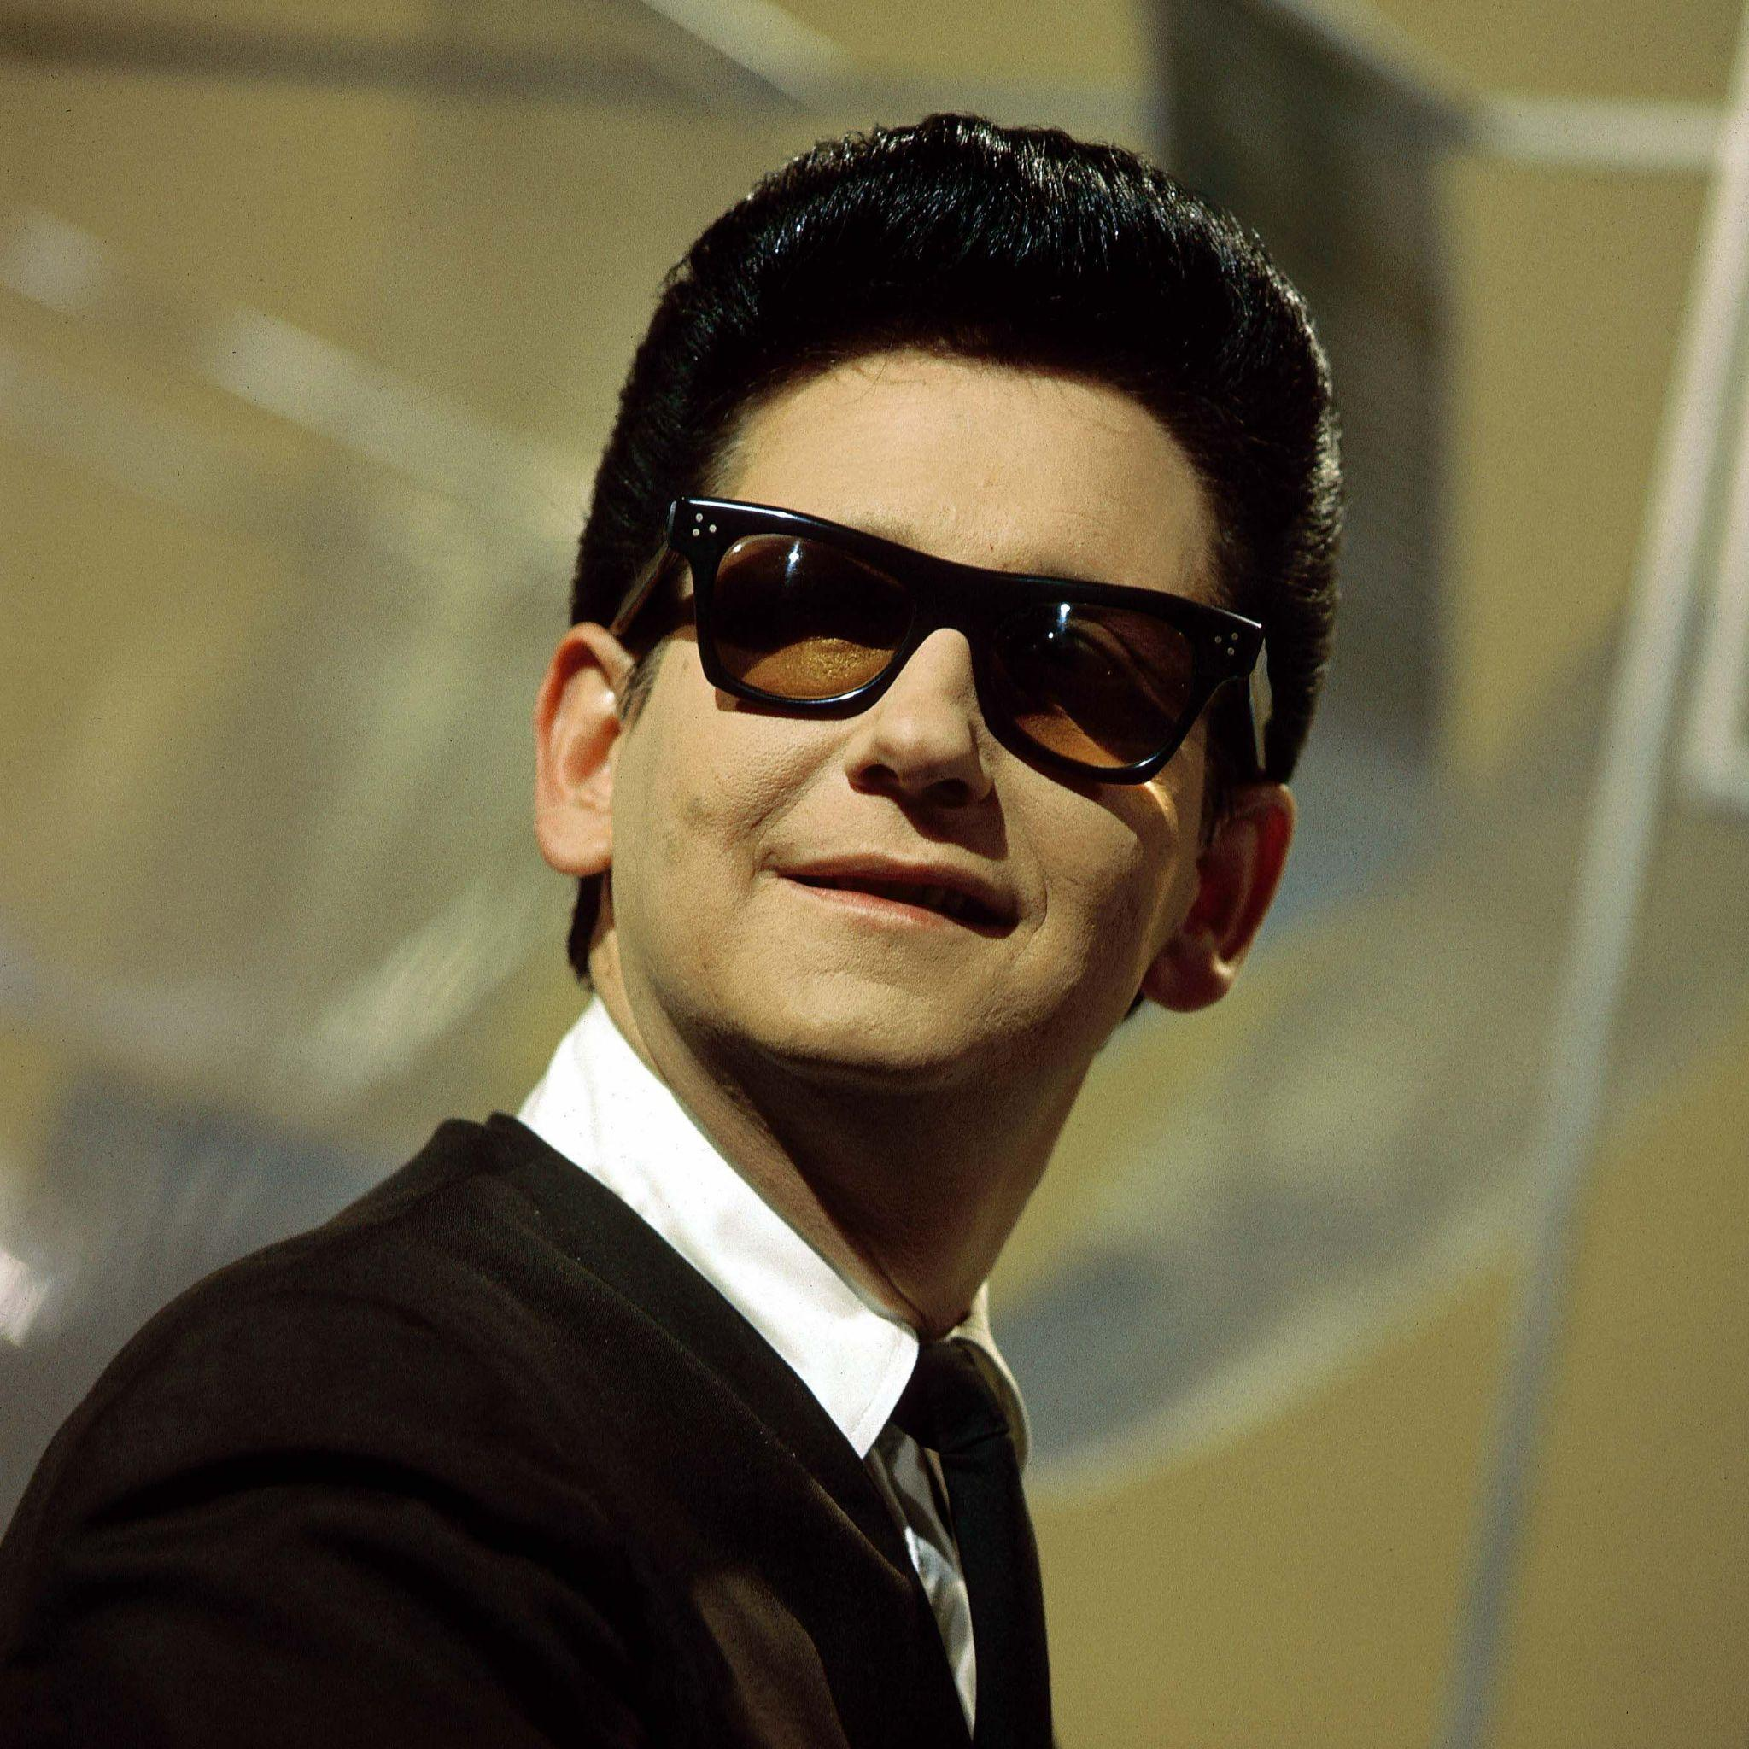
Photo from Michael Ochs Archives
Photo by David Redfern/Redferns
Notes:
6
Last time I introduced the previously uninitiated to 2 Live Crew and their copyright battle in the early 1990s with the owners of Roy Orbison’s “Oh Pretty Woman” a company called Acuff-Rose Music.
In a 1994 opinion, the US Supreme Court explained that where the copying creates a result that is transformative in character, then courts should place far less importance on the distinction between commercial vs non-commercial copying that was historically so important to the analysis of a claim of Fair Use as a defense to copyright infringement.

Slide 7
Fair Use
An “affirmative defense” that excuses copying in certain, limited circumstances.
Four-Factor Test (17 U.S.C. § 107):
Purpose & character of use
* “transformative use” *
Nature of the copyrighted work
Amount of the work copied
Effect on the market/value of the protected work
Notes:
7
Going back to this slide: The Court explained that parody, like 2 Live Crew’s song “Pretty Woman”, by its very nature transforms the copyrighted elements of the original work because parody’s [click] purpose is to comment on the original work or its themes. Parody, then, is likely to be fair use even where the new work [click] borrows heavily from an original, [click] highly creative work, without regard for whether the new work may [click] divert some consumers away from the original.
And that was when and how transformative use was born. Though it usually nests under the first Fair Use factor, we discussed last year how it seems to have a way of informing the entire fair use analysis a court must perform.

Slide 8
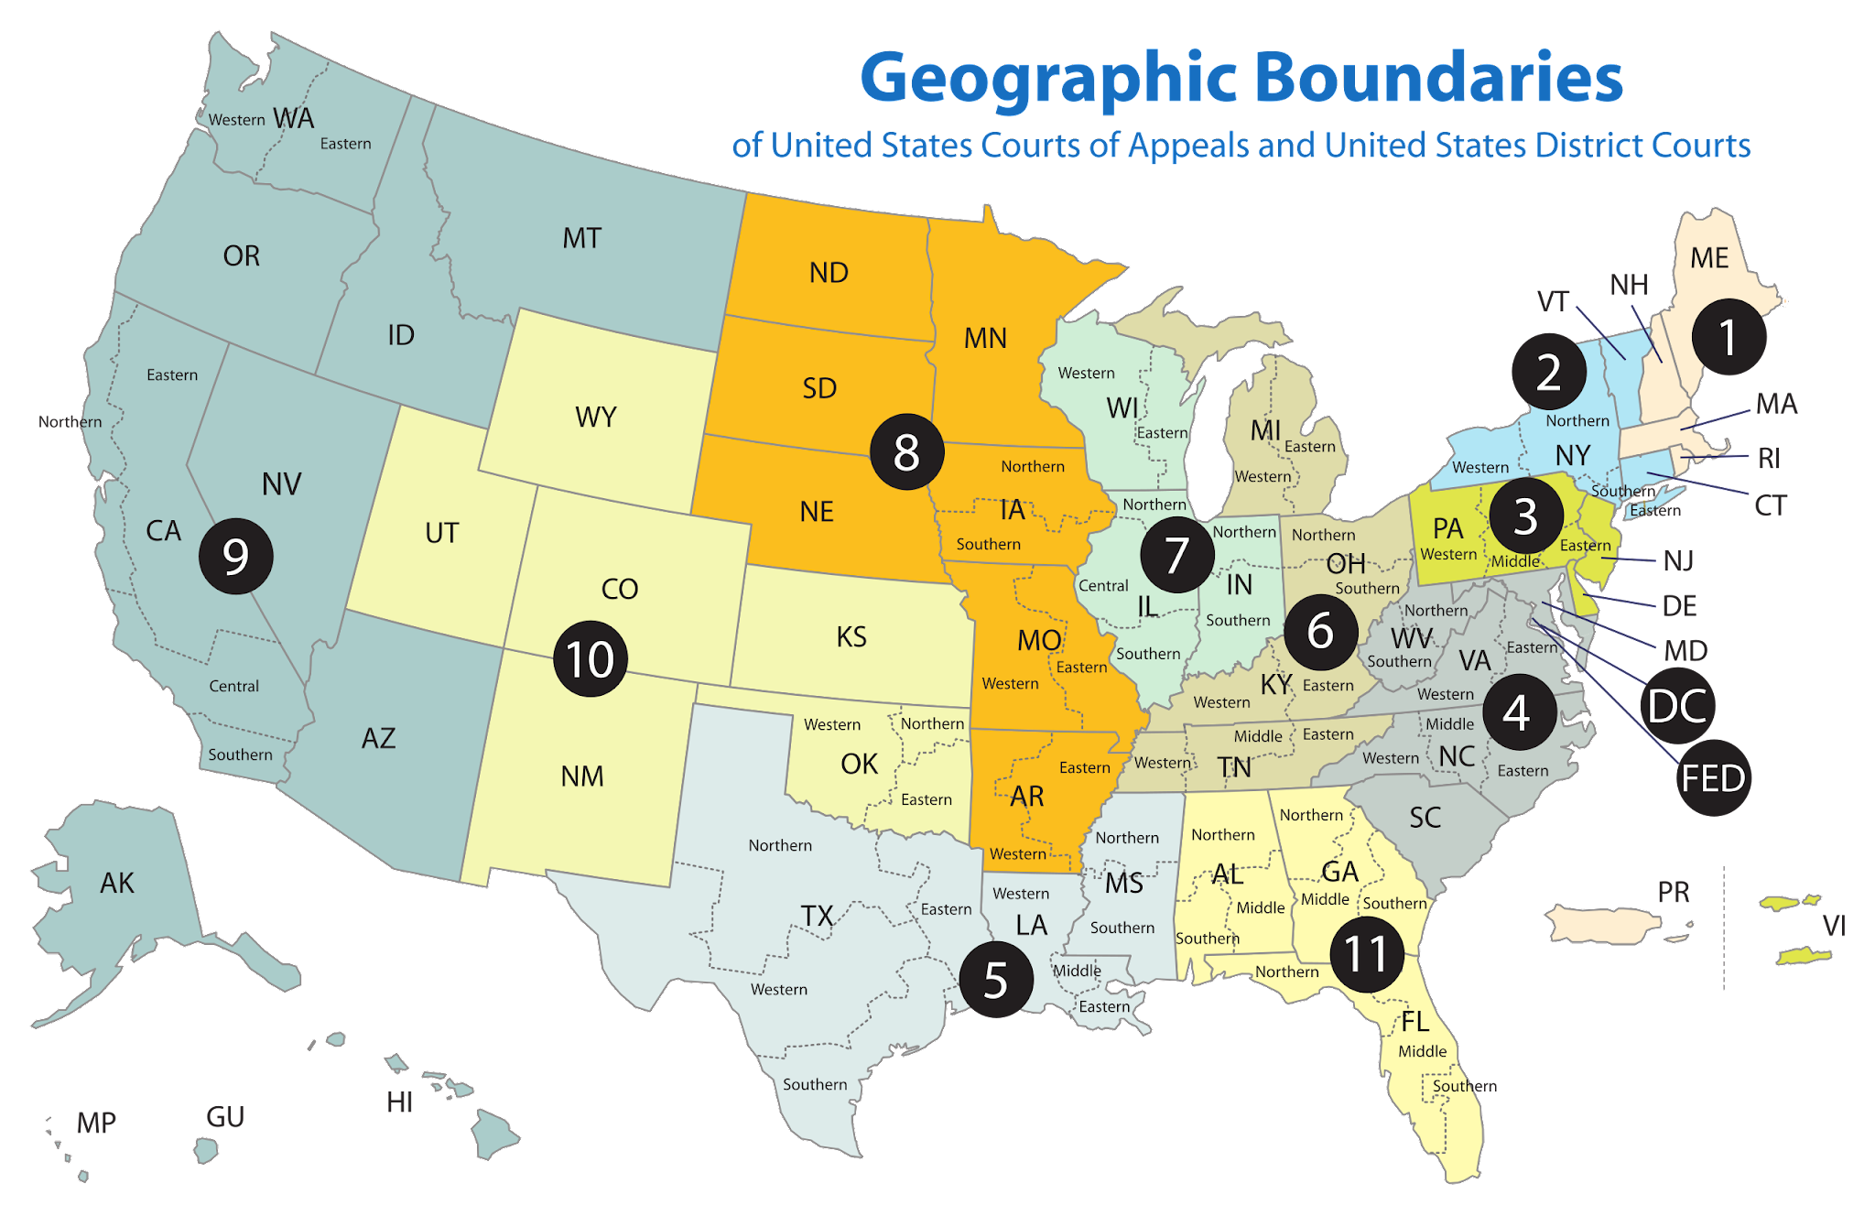
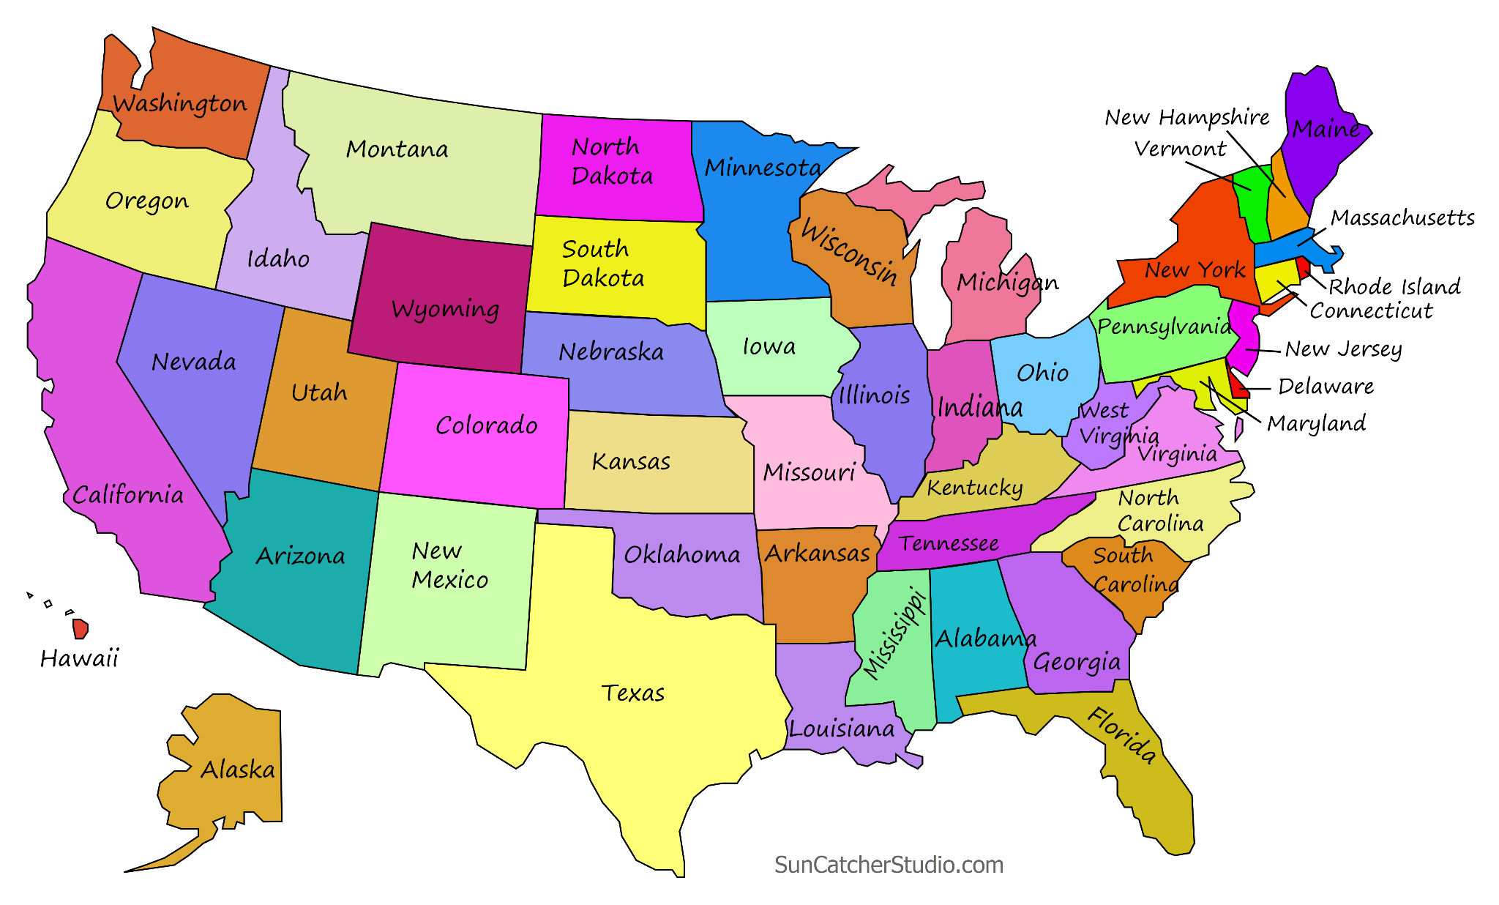
Notes:
8
Each of the 50 US states has its own series of state courts, with trial courts and appellate courts and a court of last resort. In issues of copyright law, those simply don’t matter. Copyright law is one of a handful of areas where Congress has said “states–you can’t make any laws about this at all.” This is called Federal Preemption, meaning that federal law, that is law made by the US Congress and applicable throughout the United States, completely covers the field. So the legal map that matters is …

Slide 9
Notes:
…this one.
Because in addition to the state court system, there is a parallel and independent system of federal courts. These courts have jurisdiction to hear two distinct types of cases: the type that matters here is where the law in question is a federal law. All copyright cases, because of Federal Preemption, are in that category.
So within the geographical borders of each US state are some number of federal judicial districts, each which contain some number of trial courts, called federal district courts. These are not uniform but are generally distributed based on population.
Now, the coloring on this map groups the federal districts into Courts of Appeal. So, the green states out West are in the Ninth Circuit Court of Appeal, the light blue states that include my current home state of New York are in the Second Circuit Court of Appeal, etc.
Often, these Circuit Courts of Appeal reach different conclusions on how to interpret and apply the law, which creates what’s called a Circuit Split. Sometimes they persist for decades before the United States Supreme Court steps in and resolves the split by announcing one rule that applies everywhere. Unless and until that happens, a legal rule announced in the Ninth Circuit Court of Appeal, for example, only has legal effect in the geographic territory covered by the Ninth Circuit. So, even federal law is often applied differently in different parts of the United States.

Slide 10
Notes:
10
These are the headlines from my opening slide. And here is our map of the 13 Federal Circuits. You’ll see there are two districts on opposite sides of the United States: one in NY and one in CA, where these cases are playing out. Specifically, the Silverman case and a few more like it started in the Northern District of California, which is basically San Francisco; and, the NYT Times suit, another suit by news publishers, and a couple of suits like California authors’ suits were filed in the Southern District of New York, which is New York City.

Slide 11
Authors Guild
Paul Tremblay (and others)
OpenAI/Microsoft
New York Times
Sara Silverman (and others)
Michael Chabon (and others)
Alden
Notes:
So, as to Open AI and Microsoft specifically, the copyright litigation map looks like this

Slide 12
Authors Guild
Paul Tremblay (and others)
OpenAI/Microsoft
Tremblay (and others)
CONSOLIDATED
New York Times
Sara Silverman (and others)
Michael Chabon (and others)
Alden
Notes:
These three lawsuits in California, all brought by groups of fiction writers [5 clicks], were consolidated by the court, meaning they are basically all one lawsuit from this point. [click] This Authors Guild suit in NY is pretty much the same thing, though there the authors sort of consolidated themselves before the court could, so there are a lot of fiction and nonfiction authors represented as plaintiffs in the Authors Guild case, as the name implies. Additionally in New York are these two lawsuits by journalistic outfits, the NYT and a group of newspapers owned by the Alden company. The Alden papers case was very recently folded into the NYT case, so they have been consolidated as one case with NYT as the lead plaintiff.

Slide 13
Mike Huckabee (and others)
Richard Kadrey (and others)
Llama/Meta
Kadrey (and others)
CONSOLIDATED
including Sara Silverman
Michael Chabon (and others)
Notes:
Specific to Meta and its Llama AI, it’s much simpler. This is how it started [7 clicks] This is how it’s going .
So, the only that exists as a going concern, so to speak, is called Kadrey; but, it includes the claims of all the plaintiffs who filed against Meta.

Slide 14
Notes:
14
Let’s talk a little bit about the status of that litigation against Meta and it’s Llama AI.

Slide 15
Llama/Meta
12 Feb 2024: Court dismissed all claims unrelated to the use of copyright-protected material as training data:
LLaMA language models are not “themselves infringing derivative works” just because the “models cannot function without the expressive information extracted” from the plaintiffs’ books.
There is no way to understand the LLaMA models themselves as a recasting or adaptation of any of the plaintiffs’ books.
Without any plausible allegation of an infringing output, there can be no vicarious infringement based on the theory that every output of the LLaMA language models is an infringing derivative work,” and that because third-party users initiate queries of LLaMA, “every output from the LLaMA language models constitutes an act of vicarious copyright infringement.”
Notes:
Earlier this year, the claims against Meta were shaved way down. In short, the judge said the only viable claims were the claims that the existence of copyright-protected materials within the training data for the LLM constituted copyright infringement. In other words, the court did not allow these plaintiffs to pursue a claim that the models themselves created infringing outputs when prompted by users. That’s really all these bullets say.

Slide 16
Llama/Meta
ORDER. Based on previous filings, the Court has been under the impression that there's no real dispute about whether Meta fed copyrighted works to its AI programs without authorization, and that the only real legal question to be presented at summary judgment is whether doing so constituted "fair use" within the meaning of copyright law. If that's correct, it's difficult to understand why adjudication of that issue at summary judgment should be delayed beyond March 2025. The parties should be prepared to discuss this issue, along with the broader questions presented by the motion to extend the case schedule, at Friday's case management conference. Signed by Judge Vince Chhabria on 9/18/2024.
Notes:
This order appeared in the electronic docket last week. The bold red emphasis is mine. [read]
So, the court wants to tackle the central issue head on, and it wants to do it as soon as possible.
For those who don’t know, summary judgment is something of a shortcut step to deciding a claim on the merits. A party presents in writing to the Court what it states are the UNDISPUTED facts and argues that based on those undisputed facts, that party is the winner and the other party is the loser. The other party then has the chance to say both (1) no, those facts are not UNDISPUTED or (2) there are these other UNDISPUTED facts that matter or (3) there are other DISPUTED facts that matter or (4) even if these facts are both undisputed and the only ones that matter, the other side does NOT in fact win for these reasons…..

Slide 17
Thomson Reuters v. ROSS Intelligence Disputed Facts in the Fair Use analysis:
What did ROSS’s AI do with the copyright-protected language it ingested?
What is the likely market impact of an AI-powered legal search platform?
What is the public benefit of ROSS’s activity?
Notes:
Last year in Vienna, I mentioned the lawsuit between the global publishing giant TR and the Canadian AI legal research company ROSS intelligence. The judge in that case had recently refused summary adjudication on Westlaw’s claim of copyright infringement and ordered the case to a trial by jury, finding that these and other questions were questions of fact that a jury had to decide as part of the fair use analysis. Something similar may well happen with the Meta case, where the Court may well find that these same sorts of questions are highly relevant to the fair use analysis and then defer their answers at least in part to a jury.

Slide 18
Notes:
Moving on to Open AI/Chat GPT

Slide 19
OpenAI/Microsoft
9th Circuit (California)
Prior to consolidation: everything but direct infringement trimmed from the Silverman suit (12 Feb 2024)
After consolidation: case is very similar to the Meta case we just discussed
2nd Circuit (New York)
Authors Guild case mirrors the California case
News cases (NYT & Alden): recently consolidated.
Present unique issue of “output” copying
Notes:
So, this slide is basically review. The California cases, if you will, are all consolidated and now what the judge in the Meta case, who is a different judge by the way, wrote about fair use being the sole issue in that case could probably also be said about these ChatGPT cases, included the Authors Guild case in NY.
What’s different is the newspaper case, the consolidated NYT case, because the issue of output copying is still very much alive there.

Slide 20
“Input” copying vs “Output” Copying
Input copying: The use of copyright-protected works to train LLMs
Output copying: When generative AI creates an identical copy, or a derivative work, of a copyright-protected work
Notes:
I didn’t use the terms input copying and output copying when I talked about the Meta case being trimmed way down, but it’s precisely this same issue. I said that judge isn’t allowing the author plaintiffs to continue to pursue a claim of what we’re now output copying—that case is entirely about so-called input copying.

Slide 21
“Input” copying vs “Output” Copying
This motion does not seek to resolve the core issue of whether using copyrighted content to train a generative AI model is fair use under copyright law. That key question will require the development of record evidence to show, inter alia, that Plaintiffs have flagrantly mischaracterized what OpenAI’s products are and how they work. To take just one example of many, the suggestion that ChatGPT can be used to generate at will the verbatim text of newspaper articles is obviously and demonstrably false. Plaintiffs’ contrary suggestions depend on an elaborate effort to coax such outputs from OpenAI’s products, in a way that violates the operative OpenAI terms of service and that no normal user would ever even attempt, combined with a willfully misleading presentation of the results. At the end of the day, the truth will emerge, and it will be clear that ChatGPT is not in fact some highly inefficient way to access, via one out of every thousand or so impermissible attempts, snippets of old newspaper articles that are freely available in full elsewhere online.
from Defendants’ Mot. to Dismiss the Alden Papers’ Complaint, 11 June 2024
Notes:
This is from a court document filed by ChatGPT’s lawyers in the newspaper case, and it summarizes the two kinds of alleged copyright infringement at issue. ChatGPTs allegations in orange there are fairly well publicized. But, the case is still too young procedurally for the court to have a chance to decide whether what OpenAI says about what must be done in order to “trick” ChatGPT into output infringement is true. So, for the newspaper plaintiffs, and JUST the newspaper plaintiffs, this question of so-called output infringement is still a live question.

Slide 22
Input Copying, Fair Use, and Transformative Use
United States Supreme Court:
Campbell v. Acuff-Rose Music 510 U.S. 569 (1994)
Google LLC v. Oracle America, Inc. 141 S. Ct. 1183 (2021) Andy Warhol Foundation v. Goldsmith 143 S. Ct. 1258 (2023)
Notes:
As for input copying, this issue of whether the LLM training data containing copyright-protected data, is a violation of copyright not subject to a fair use defense: that’s where it gets really interesting. There are only three US Supreme Court cases that address copyright fair use. They are these three, and we discussed them each in Vienna. We’ve already mentioned the Campbell case today, as that’s the one where Transformative Use was born.

Slide 23
Fair Use Factors
Google LLC v. Oracle America, Inc. 141 S. Ct. 1183 (2021)
Purpose & character of use
Nature of the copyrighted work
Amount of the work copied
Effect on the market/value of the protected work
Notes:
In the 2021 case of Google v. Oracle, our Supreme Court ruled that Google’s copying of Java API’s, which were copyrighted by Oracle, was fair use. The Court said [Click] First, Google’s use of the Java APIs was transformative because the copying allowed programmers to work in a different computing environment but with a familiar programming language. Second, [Click] the copied lines were “inherently bound together with uncopyrightable ideas,” suggesting it was unlikely to undermine the general copyright protection that Congress provided for computer programs. Third, [Click] Google copied only .4% of the entire API. Last and perhaps most importantly, [Click] the record showed that Google’s Android smartphone platform was not a market substitute for Oracle’s Java-based product, Java SE

Slide 24
Fair Use Factors
Andy Warhol Foundation for the Visual Arts, Inc. v. Goldsmith, 143 S. Ct. 1258 (2023)
Purpose & character of use
Nature of the copyrighted work
Amount of the work copied
Effect on the market/value of the protected work
Notes:
In 2023, the Supreme Court seemed to halt what most had considered a rapid expansion of fair use when it ruled that the Andy Warhol Foundation’s licensing of this image to a magazine was not a fair use of the original image [Click] Warhol had modified, which was taken and copyrighted by photographer Lynn Goldsmith. In short, the court found that Warhol's image was a market substitution for the Goldsmith photo, as evidenced by the magazine licensing agreement in question.

Slide 25
Input Copying, Fair Use, and Transformative Use
United States Supreme Court:
2nd Circuit Court of Appeals:
Campbell v. Acuff-Rose Music 510 U.S. 569 (1994)
Google LLC v. Oracle America, Inc. 141 S. Ct. 1183 (2021) Andy Warhol Foundation v. Goldsmith 143 S. Ct. 1258 (2023)
Authors Guild v. Google, Inc. 804 F.3d 202 (2015)

Slide 26
Fair Use Factors
Authors Guild v. Google, Inc. 804 F.3d 202 (2d Cir. 2015)
“We have no difficulty concluding that Google's making of a digital copy of Plaintiffs' books for the purpose of enabling a search for identification of books containing a term of interest to the searcher involves a highly transformative purpose, in the sense intended by Campbell.”
Purpose & character of use
Nature of the copyrighted work
Amount of the work copied
Effect on the market/value of the protected work
Notes:
In 2015, the Second Circuit Court of Appeal ruled that Google did not violate copyrights when it scanned whole books so that users of its Google Books and Google Library Project search engines could find words or phrases in those books that were interesting to them. The Google search results would even include small snippets of the copyrighted works that were relevant to a user’s search inquiry. The Second Circuit said, “We have no difficulty concluding that Google's making of a digital copy of Plaintiffs' books for the purpose of enabling a search for identification of books containing a term of interest to the searcher involves a highly transformative purpose, in the sense intended by Campbell.” (remember Campbell is the Pretty Woman rap parody case where the Supreme Court created Transformative Use in 1994)
So this is a case where even though many of the copyrighted works were [Click] highly creative and Google copied the entirety of the work the purpose of the copying was so transformative as to predominate over the entire fair use analysis.
This opinion stresses the relationships between the factors, and how these relationships can inform a court’s overall analysis. For example, [Click] the opinion ties the first two factors together, explaining that when the copying is for a transformative purpose, what matters about the nature of the copyrighted work is not whether it is a highly creative work or something more strictly factual, but instead whether the objective of the original work is the same as the objective of the infringing work. Now, some of you might be saying, “isn’t objective closer in meaning to purpose in the first factor than nature in the second factor?” To which I say, yes. Yes it is.
The court also identifies a relationship between [Click] the third factor and fourth factor, saying it doesn’t matter if the whole work is copied for fair use analysis so long as the resulting, transformative work is not meant as a market substitution for the original work. The US Supreme Court refused to hear the authors’ appeal of this outcome, therefore leaving undisturbed the Second Circuit’s ruling in favor of Google.

Slide 27
Input Copying, Fair Use, and Transformative Use
United States Supreme Court:
2nd Circuit Court of Appeals:
Campbell v. Acuff-Rose Music 510 U.S. 569 (1994)
Google LLC v. Oracle America, Inc. 141 S. Ct. 1183 (2021) Andy Warhol Foundation v. Goldsmith 143 S. Ct. 1258 (2023)
Authors Guild v. Google, Inc. 804 F.3d 202 (2015)
9th Circuit Court of Appeals:
Sega Enterprises, Ltd. v. Accolade, Inc.
977 F.2d 1510 Perfect 10, Inc. v. Google, Inc.
508 F.3d 1146 (2007)

Slide 28
Fair Use Factors
Sega Enterprises, Ltd. v. Accolade, Inc.
977 F.2d 1510
“Intermediate copying” of Sega Genesis video game system’s code for the purpose of making games playable on the Sega Genesis system was fair use.
Perfect 10, Inc. v. Google, Inc.
508 F.3d 1146 (2007)
Display as thumbnail images of copyright-holder’s photographs in response to user search inquiries was fair use because Google put the images to a use that was fundamentally different than what the owner had intended, and Google’s use provided a significant benefit to the public
Purpose & character of use
Nature of the copyrighted work
Amount of the work copied
Effect on the market/value of the protected work

Slide 29
AI Arguments
- No copy “in a fixed medium”
- Copying for “internal use only” isn’t protected - Fair Use (because it’s Transformative)

Slide 30
Article I, Section 8, Constitution of the United States
The Congress shall have the power . . .
To promote the progress of science and useful arts, by securing for limited times to authors and inventors the exclusive right to their respective writings and discoveries.
Historical
Contemporary
“the more the appropriator is using the copied material for new, transformative purposes, the more it serves copyright's goal of enriching public knowledge and the less likely it is that the appropriation will serve as a substitute for the original or its plausible derivatives, shrinking the protected market opportunities of the copyrighted work.” 143 S. Ct. at 1276 (quoting 804 F.3d 202 at 207)
Notes:
Copyright law stems from a provision in our Constitution empowering Congress to make laws for the purpose of promoting the progress of science and useful arts by granting exclusive rights both to authors and to inventors. These exclusive rights, known as copyrights and patents, respectively (of course), are meant to create the incentives needed to fuel the engine of progress.
What the doctrine of transformative use seems to have done is to have shifted the discussion from its [Click] historical focus on the incentive itself, [Click] namely how much dilution of the exclusive right was tolerable as fair use before real harm was done to the value of that right [Click], to a [Click] contemporary view that prioritizes how fair use fits into the goal of [Click] promoting progress. Thus, so long as the derivative work represents real progress, the harm to the economic interests of the original copyright holder is subordinated.
As the Second Circuit said in the Google Books case, and the Supreme Court repeated in the Andy Warhol case: “the more the appropriator is using the copied material for new, transformative purposes, the more it serves copyright's goal of enriching public knowledge and the less likely it is that the appropriation will serve as a substitute for the original or its plausible derivatives, shrinking the protected market opportunities of the copyrighted work.”

Slide 31
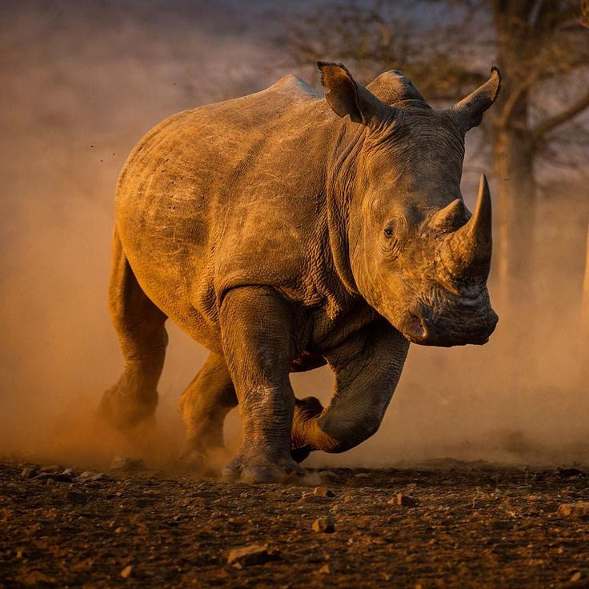
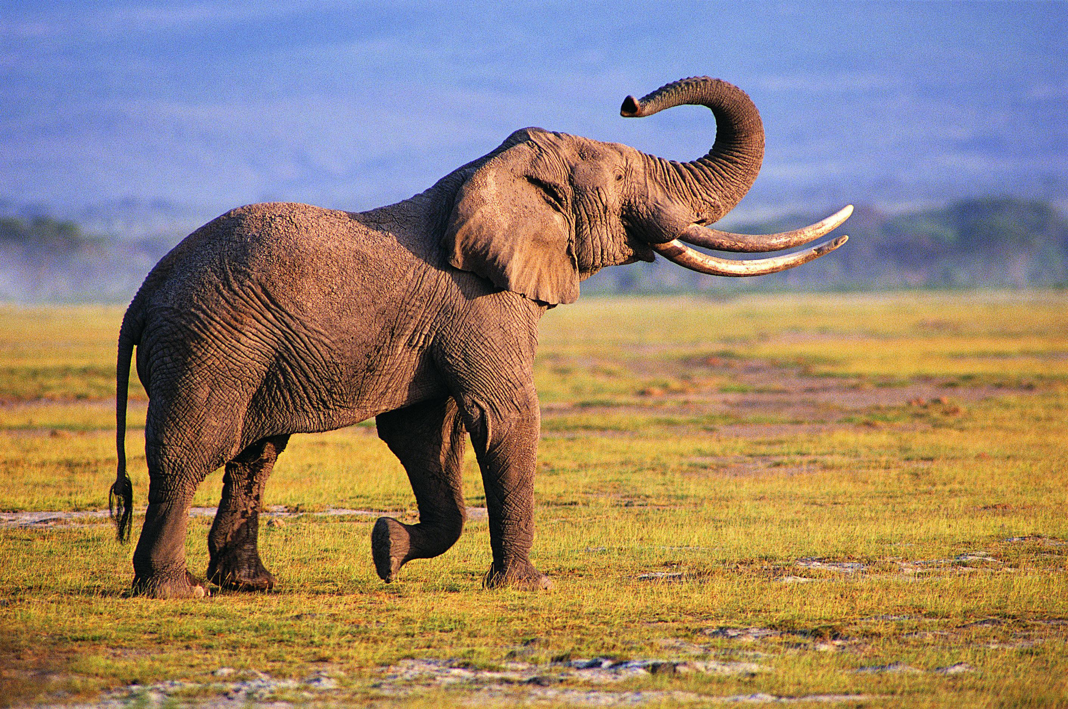
Conclusion

Slide 32
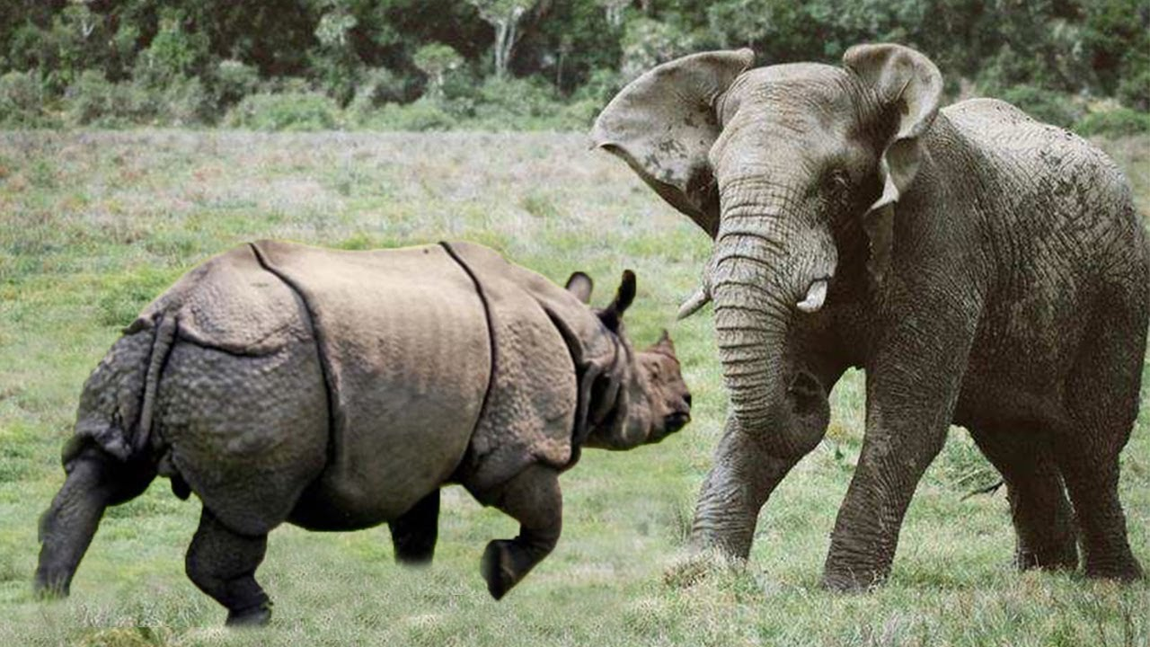
Conclusion

Slide 33
Conclusion

Slide 34
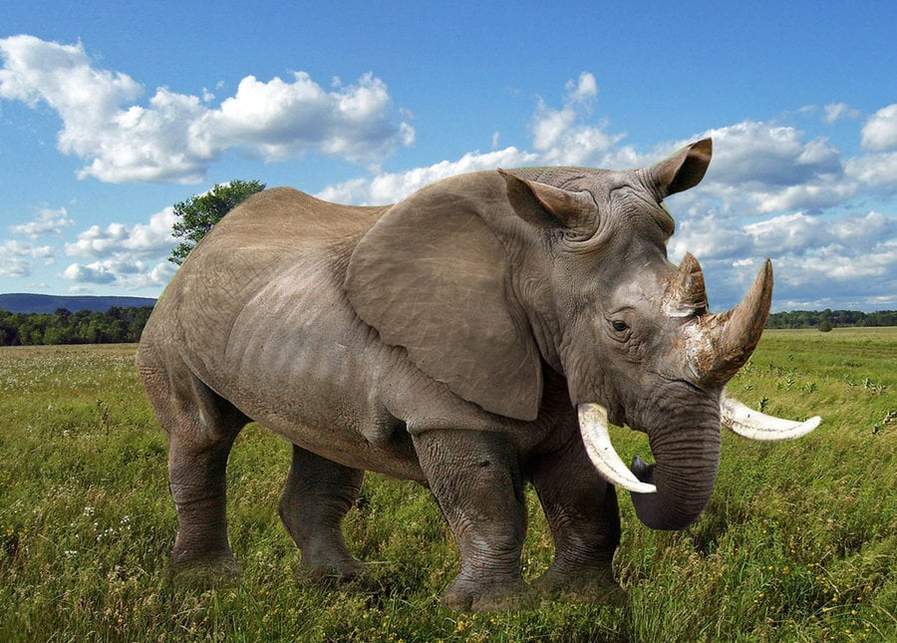
Conclusion
The End

