Slide 1
A Long and Winding Road Active disclosure of public information under the new Open Government Act in the Netherlands
| KOOP
Law via the Internet
25 – 27 September 2024
Limassol, Cyprus
mr. dr. Marc van Opijnen
Adviser Legal Informatics
Publications Office of the Netherlands (KOOP)
Notes:
Story of personal frustration. Because …..
Declaration of Montreal: obligation of governments to make information available.
One of the conclusions is – at the current stage – that it is very difficult for governments that make their own information accessible for the citizen.

Slide 2
Topics
The long road to a new act
The history of the platform and the childcare benefits scandal
Architectural nightmares
Outlook

Slide 3
Government Information Act
1992
Information on request
Active disclosure of information
Notes:
Art 8: The governing body directly concerned shall, on its own initiative, provide information about its policy, preparation, and implementation, if it is in the interest of good and democratic governance.
Not elaborated.
Just a Best efforts obligation, difficult to operationalize. A dead letter.

Slide 4
Initiative Bill for Open Government Act
2012
Broader rules re information on request
Art. 3.2: the Register
Notes:
One of the most ambitious acts globally
Article 3.2
An administrative body maintains an electronically accessible public register of documents held by the administrative body.
The register contains at least the documents received for processing and the documents sent after decision-making (…)
The register provides everyone access to the documents listed in the register that have been made public or indicates how documents can be accessed that cannot be made available in electronic form.

Slide 5
Initiative Bill for Open Government Act
2012
Broader rules re information on request
Art. 3.2: the Register
Mandatory active disclosure of 17 information categories
Other information: best efforts obligation
1000 organisations
Notes:
Infocats: Legislation, Organisational information and contact details, Legislative proposals & related reports; incoming documents that require decision-making; parliamentary documents; meeting documents of regional representative bodies; agenda and meeting documents of administrative boards; public-private partnerships; annual reports; OGA requests for information + documents handed-down; research reports; decisions on complaints; decisions in individual case, with a long list of exceptions.

Slide 6
Registers or Platform?
2017 – 2018
Registers too complicated, €€€
A voluntary platform by KOOP: PLOOI
Reference index to local websites
With optional publication & storage services
For the citizen: 1 platform instead of 1000
First client: ministries (webclient)
Notes:
Here visible that it concerns an Initiative Bill, which the government basically didn’t want – in this form. Advisory report: Register too complicated and costly
How should the active disclosure be realized? 2018: Report by KOOP with idea to facilitate publishing
Under development: KOOP could develop its own policy

Slide 7
Development
2018 – 2021
2018 first plan, agile on paper
2019 architecture, too complicated & ambitious
2020 work, too many teams
2020 pilot
2021 simpler model
Notes:
Funding, organisational problems
The Rebuild still based on the voluntary model
Too few good indians, too many chiefs
Some municipaliies, archive of 100.000 central documents

Slide 8
A Change of Plan
2021
Childcare benefits scandal
Deplorable state of internal information systems
While OGA under debate in Senate
Introduction of art 3.3b
Notes:
Art 3.3b: "The disclosure of the documents referred to in Articles 3.3 and 3.3a is carried out electronically in a generally accessible manner through a digital infrastructure maintained by Our Minister. This infrastructure is available for the disclosure of other documents.“
Explanatory memorandum:
refers to the portal already developed. (but was still in the making)
Described as a publication Platform
One search page for citizen voor 1000 organizations
"Moreover, this reduces the total costs of disclosure, and administrative bodies do not need to develop facilities for this themselves. Therefore, this platform is made mandatory with Article 3.3b.“

Slide 9
A Change of Strategy by KOOP
2021-2022
Entry into force 1 May 2022
PLOOI from service product to mandatory system
More responsibility for the Ministry
Existing platform immature
One size fits all
push API & storage, mandatory
metadata
Notes:
But not article 3.3 !
In line with the explanatory memorandum …. Which was drawn up in a great rush (political crisis) and without proper consideration – and knowledge of the then existing portal.

Slide 10
Resistance
2022
Regional bodies: cost and metadata
IT watchdog:
Stop development
Start reference index with what is already available
Harvest documents for indexing
No requirements on metadata
Develop vision for the platform
Notes:
Confusion Ministry:
What is harvesting?
Instead of indexing local websites available, it was decided – contrary to the promises of the explanatory memorandum – to obligate all organisations to implement its own web repository.

Slide 11
Current State of Play
2024
Ministry: compliancy with OGA requires:
Entry in OGA index
Local storage
Sitemap architecture
Portal for documents
(Responsibility for) vision unclear

Slide 12
Current State of Play
2024
Ministerial regulation
Staged entry into force
Complicated definitions
Different workflows
GDPR and other exceptions
Metadata
First stage: promulgated legislation, contact & organisational details, already available
Reconsidering central services

Slide 13
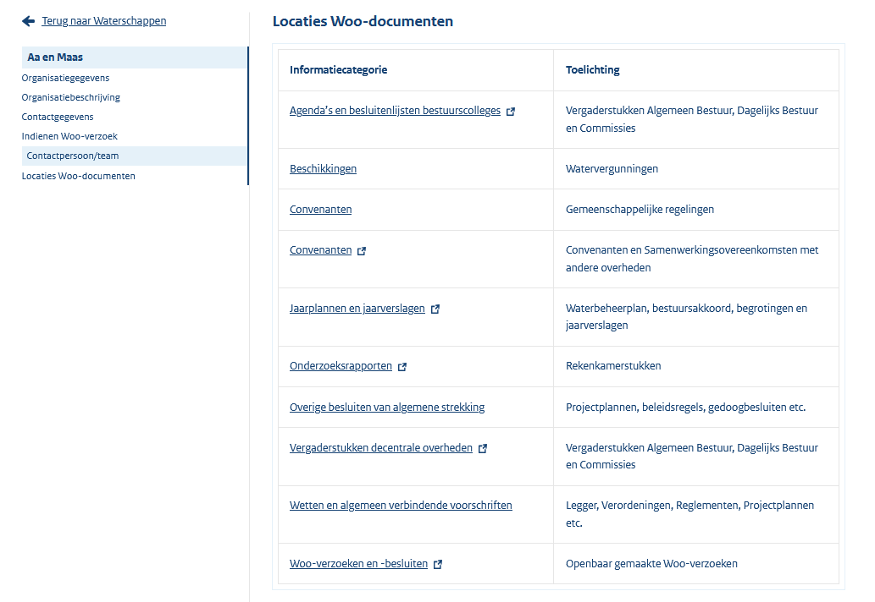
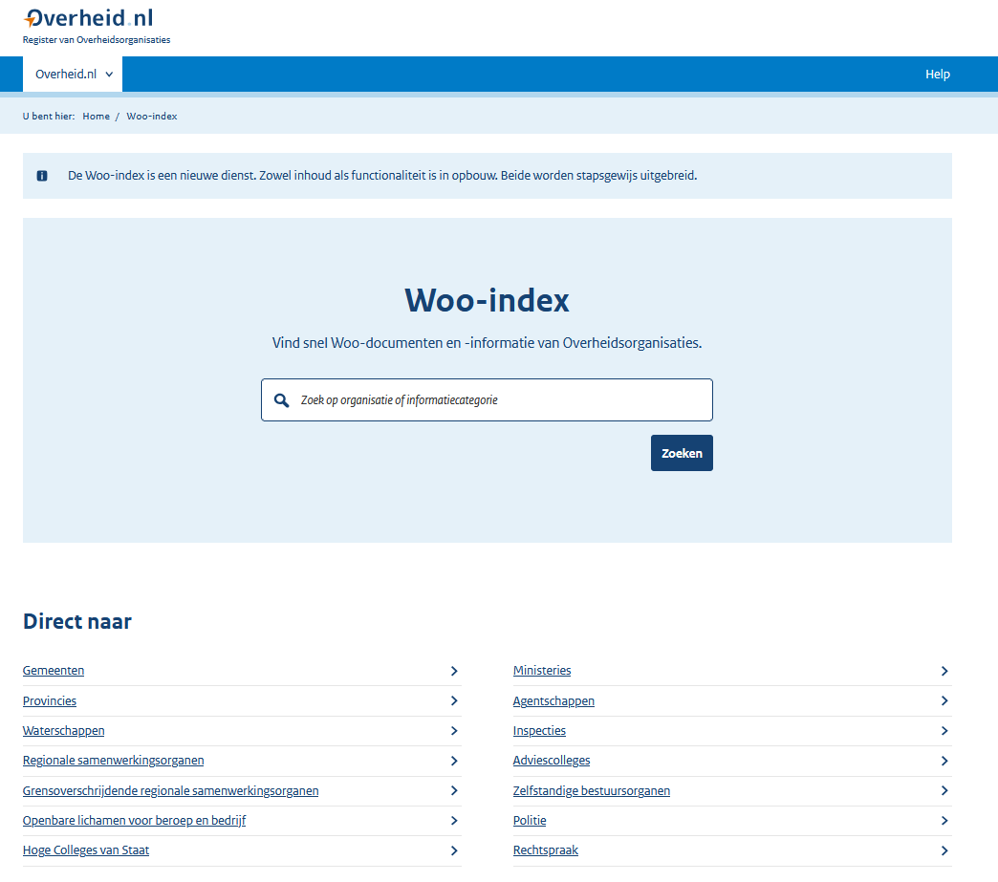
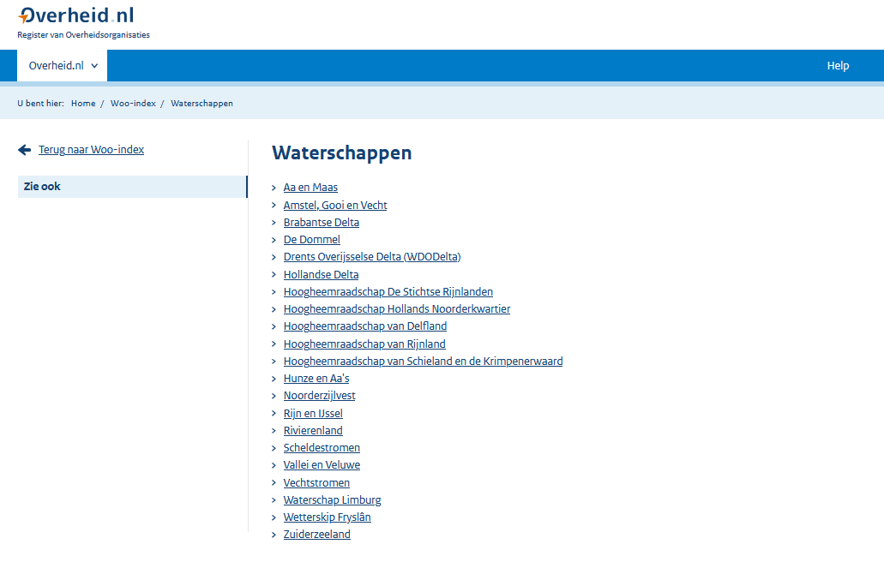
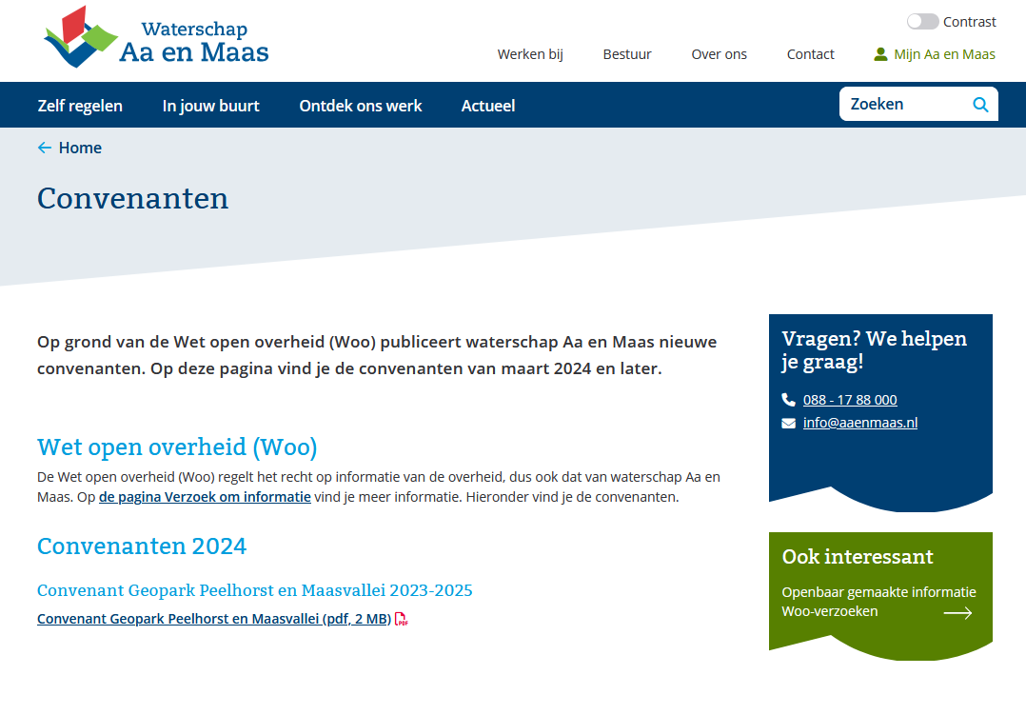

Slide 14
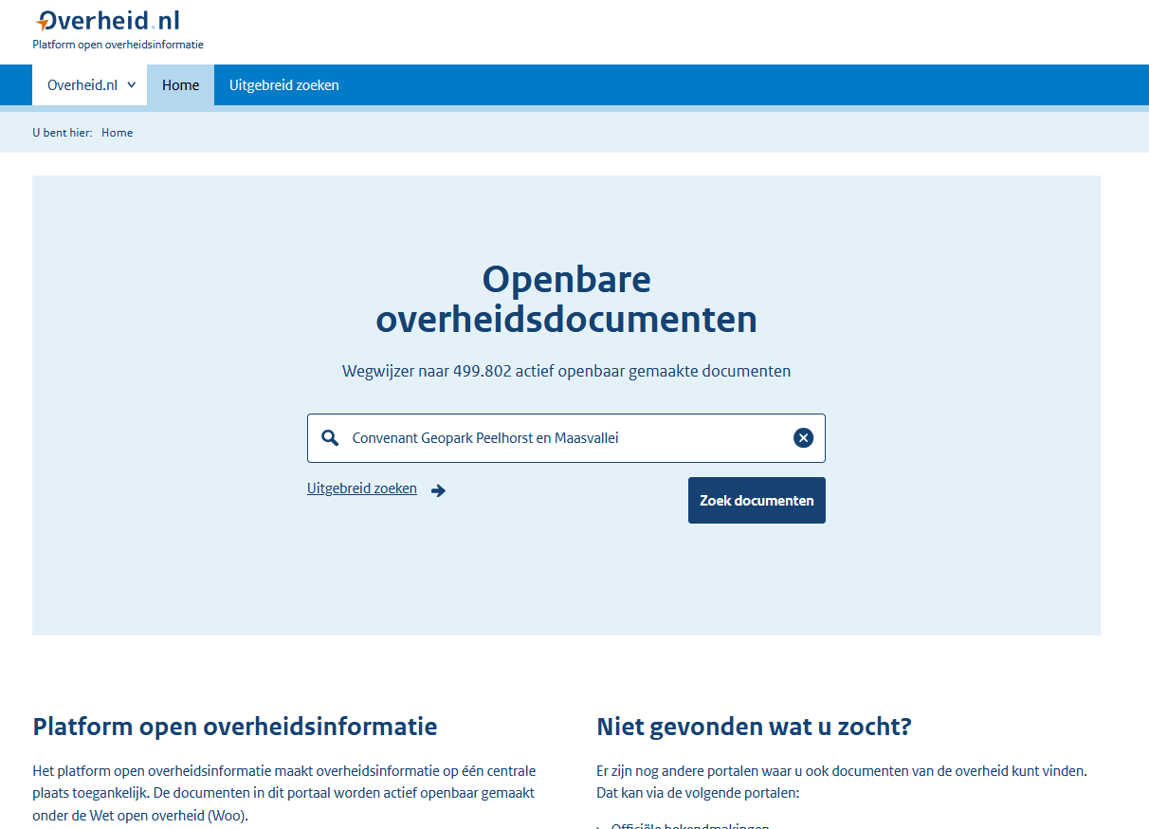
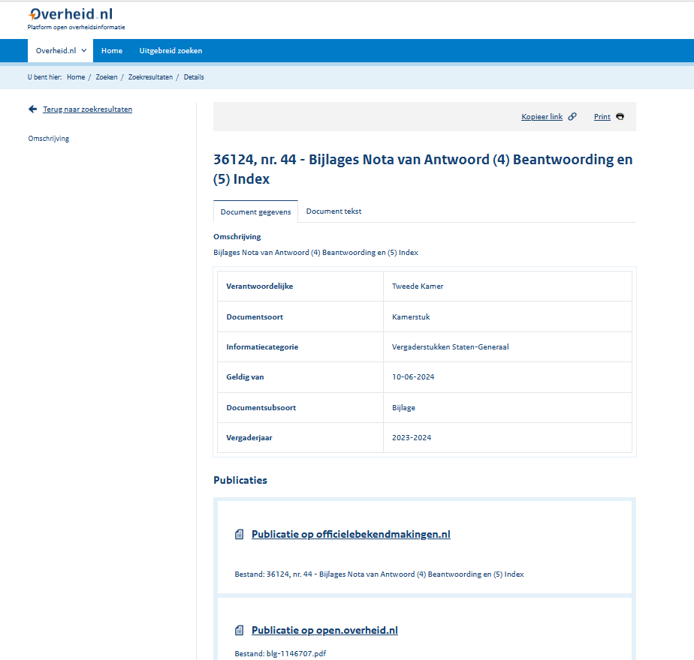
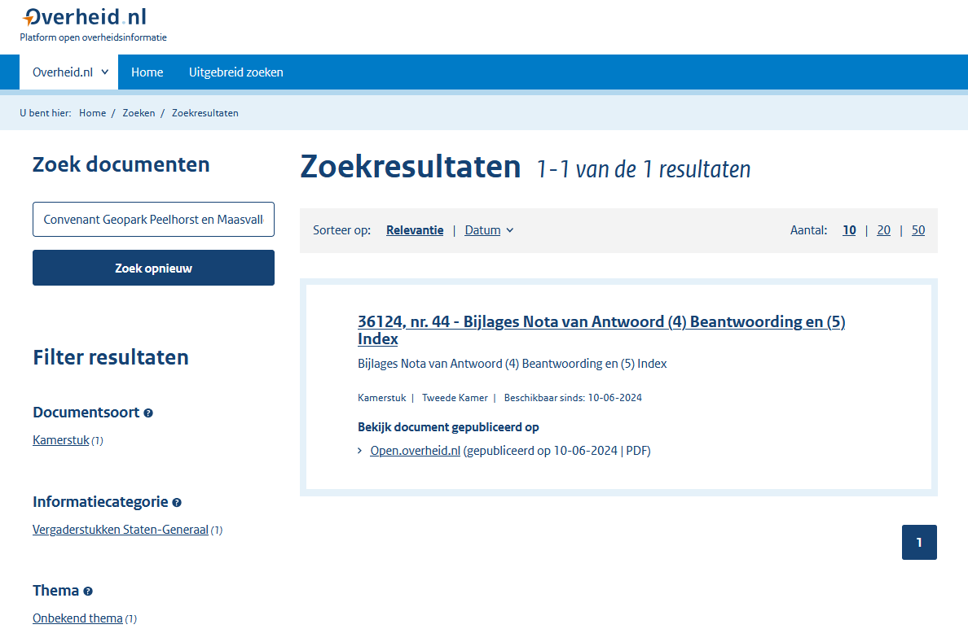
Notes:
Reason:
It is in the index, but the harvester is currently not implemented, obviously.
ALL IN ALL: a little bit disappointing after 6 years of development.

Slide 15
Woogle
Notes:
Concatenation of Woo & Google.
Woo is the Dutch abbreviation for OGA
Started by one man University of Amsterdam
Now an experimental site with some ambitions, to realize “PLOOI as it was intended”.

Slide 16
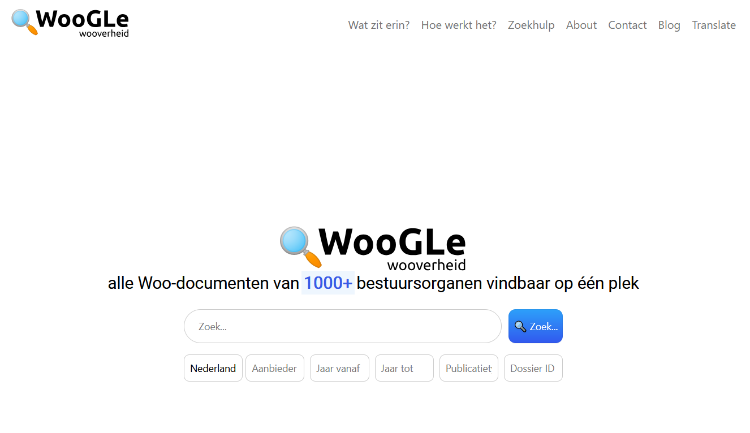
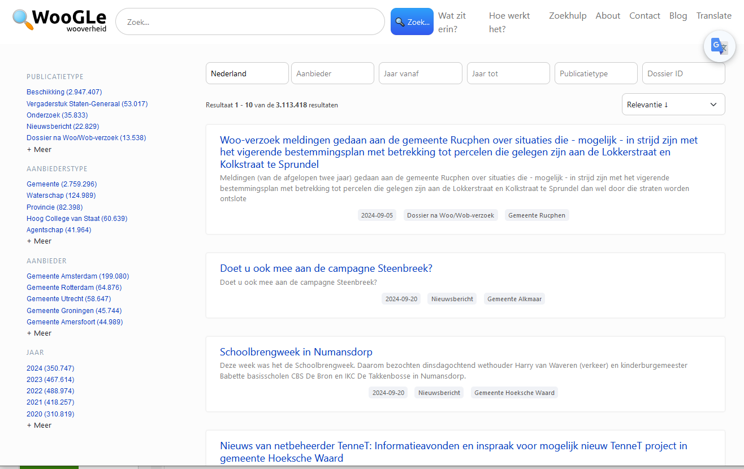
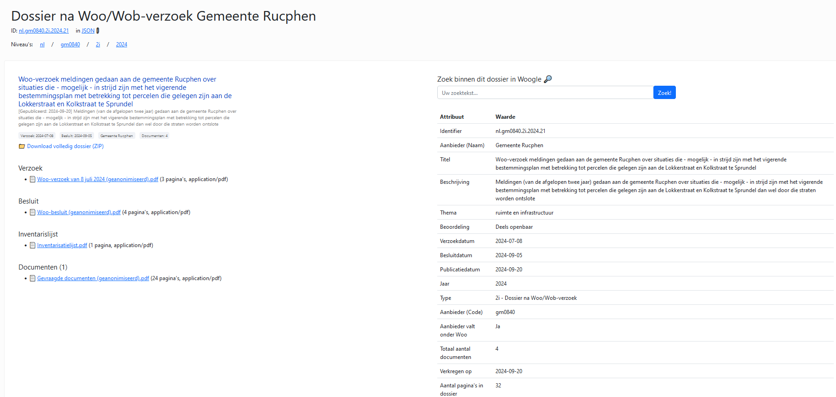
Notes:
Clear simple search form
And result list and filters
Good document page. Mind the added metadata!
Extracted by software, as well as CR and search functionalities.
Students enough, open source

Slide 17
Conclusions
“Government information? Unsearchable!”
January 2021
Government respons: Special progamme, new Archiving Act, Open Government Act
Thou shalt archive and publish!
Criteria are legally verifiable
But for search?
Inside out thinking
Everybody wants a say, but nobody takes responsibility
Initiative bill
Notes:
- We started in 2018.
- Written during Parliamentary Hearings on Childcare benefits scandal.

Slide 18
Last Slide

