Slide 1

OPEN DATA AND HUMAN RIGHTS
Biljana Nikolic, Programme Manager,
Innovative Solutions for Human Rights and Justice, DGI, Council of Europe
26/09/2024
1

Slide 2
How digital technologies contribute to knowledge management?
ECtHR case law in national databases
Indexing of texts
Summarisation
Machine translation
2

Slide 3
TJENI Project
Foster transparency of judicial decisions and Enhancing the national implementation of the ECHR
Transparency of judicial decisions
National implementation of ECHR
3

Slide 4
ECtHR case law in national databases
Enriching of national legal databases with the case-law of the ECtHR
Who is maintaining the databases? Private companies or state?
How to prepare the integration? Automated or manually?
How to update the information when law is changed?

Slide 5
Indexing of texts
Matching of keywords / tags
AI-based solutions
French Cassation Court experience

Slide 6
Cour de Cassation project: detecting divergency
AI powered tool proposes complex labeling of judicial decisions texts on the basis of which the analysis of similarity can be performed to detect case law divergence.
As guardians of the consistency, the French Supreme Court invest human resources and efforts to limit the discrepancy in the case-law. The automation of part of the analytical tasks contributes to more efficient delivery on the mission of Supreme Court.

Slide 7
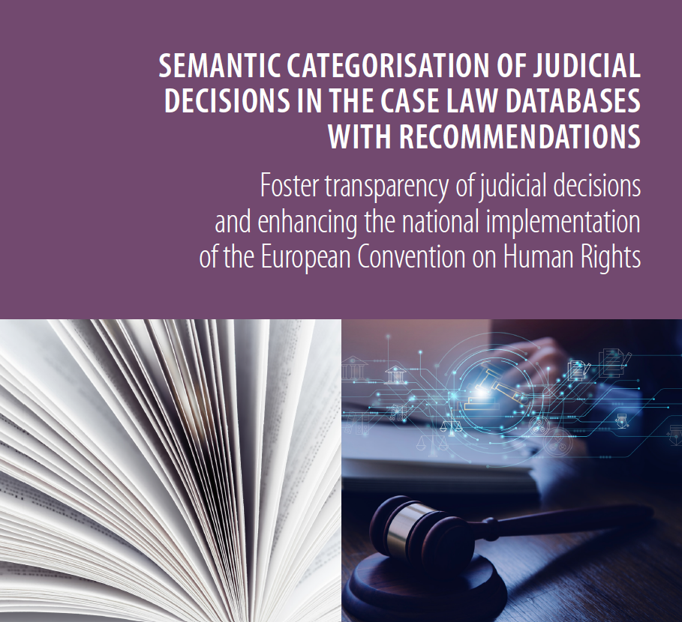
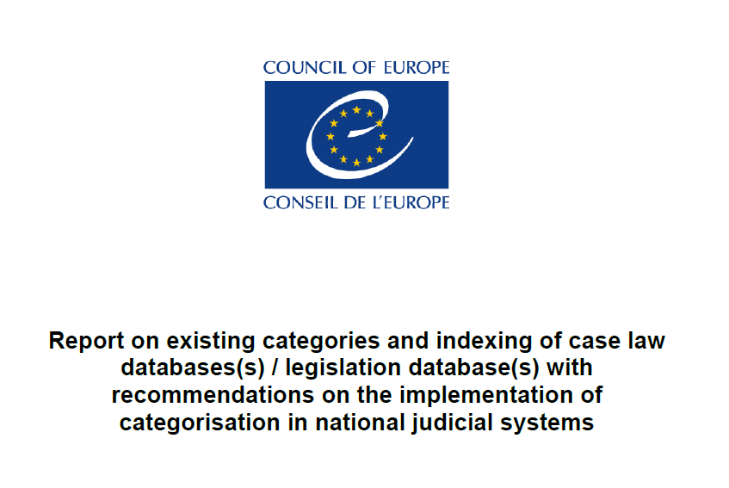
Indexing / categorisation

Slide 8
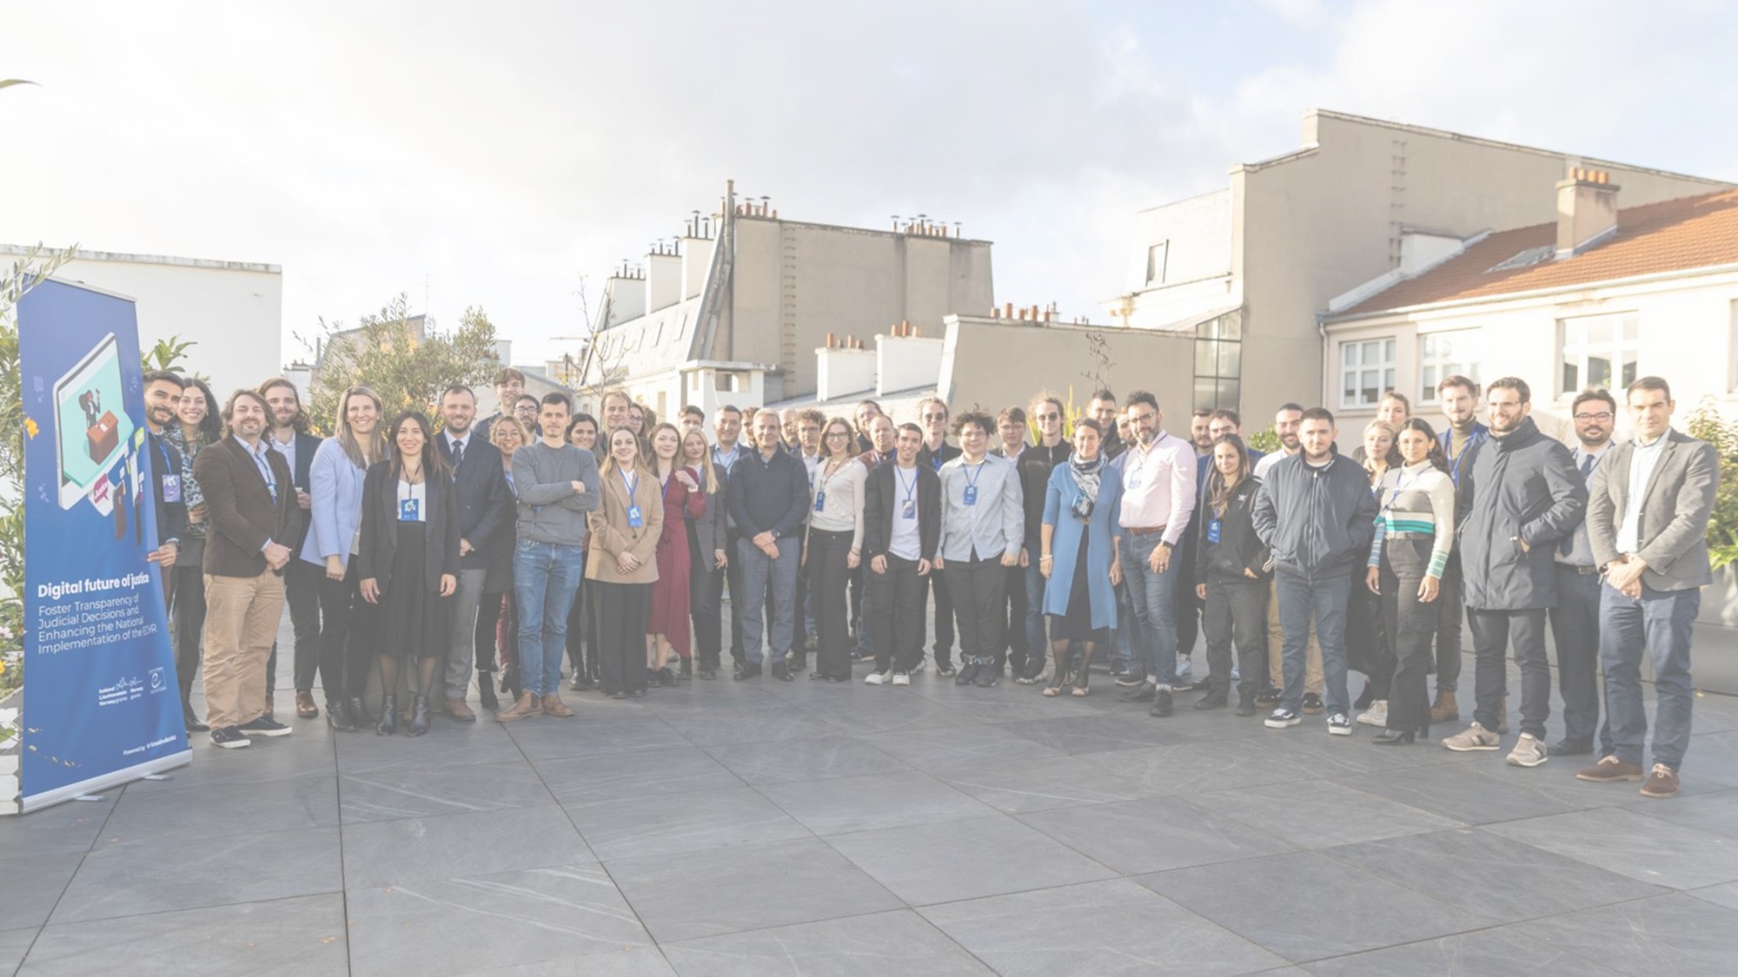
Digital future of Justice hackathon

Slide 9
Summarisation
To draft judgment (documents in the case file)
To publish judgments
To analyse: jurisprudence, its consistency or possible reforms (or friendly settlement)

Slide 10
Risks
misleading about the reasoning
missing of an important arguments => fair trial issue

Slide 11

Challenges
Extractive: lose of logical chain between elements of reasoning
Abstractive: misinterpretation of the reasoning or replacement of established legal terms

Slide 12
Tests of AI tools under TJENI
Methodology:
GPT-3.5
text separated into parts separately uploaded with relevant summary request (prompts)
answers obtained were used only if good enough, when not sufficiently clear a follow up question was prompted
resulting text was edited, but no text added
original summary of ECtHR judgment (produced by human) was used as a model of the result at which the exercises was aimed

Slide 13
Tests of AI tools under TJENI
Scoring:
Each part scored separately:
  Topic/Labelling
  Facts
  Law
  Conclusion
  Remedies
2 dimensions:
  Correctness
  Completeness
3-steps scale:
  0: wrong information/incorrect language
  1: needs improvement
  2: correct information/clear language (understandable)

Slide 14
Conclusions
Automated summarisation - great potential for fast and effective legal research and judgment preparation by judiciaries
The results shall be verified by the legal professionals who are / were involved in the preparation of the judgment in the case
Summarisation of facts in test in English was not complete
Summarisation in Greek language week in general
Limitations for non-latin scripts
Risks of commercial tools: human rights compliance (personal data) due to lack of transparency and potential bias

Slide 15
How to address possible risks?
CM Recommendation CM/Rec(2020)1 on the human rights impacts of algorithmic systems
In judicial contexts, where algorithmic systems are used for legal analysis or risk assessment, adherence to fair trial guarantees is paramount. The term 'high risk' applies when these systems may lead to serious consequences or infringements on human rights, particularly in situations lacking alternatives or where distributive injustice may occur.

Slide 16
Hurbain v. Belgium 57292/16, Grand Chamber judgment of 4 July 2023
In this case a Newspaper publisher (Hurbain) was ordered in a civil judgment to anonymise, on grounds of the “right to be forgotten”, the electronic archived version of an article originally published in 1994 in the newspaper’s print edition and placed online in 2008. The article mentioned the full name of G., the driver responsible for a fatal road-traffic accident.
In its Grand Chamber judgment of 4 July 2023, the European Court found no violation of the ECHR (and namely the freedom of expression and press freedom) on the account of the actions of the Belgium courts, who ordered the anonymisation of the article.
In the case the balancing of two rights at stake (Article 10 - freedom of expression v. Article 8 - right to privacy), both of which are of equal value, was necessary.

Slide 17
Conclusions
Keep in mind fundamental rights and the rule of law
COE instrument provide guidances and recommendations
Effective remedy shall be available

Slide 18
Thank you!
biljana.nikolic@coe.int
26/09/2024
18

